Slide 1
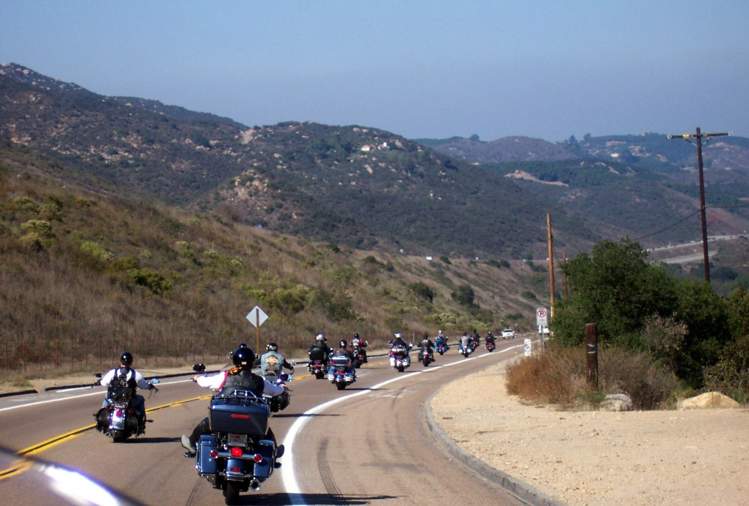
BIGGS HOG Road Guard Accident Management
Biggs Chapter North San Diego County H.O.G.
Biggs Chapter
North San Diego Chapter
Harley Owners Group
P.O. Box 610
San Marcos, CA 92079
Website: BiggsHOG.com
Ride Line: 760-736-2920
Notes:
Good morning I am Dave Yackel and I will be presenting Formation 101 to you today.
I am a Road Guard as identified by this red/orange agulete. I have been riding with Biggs Chapter for a 2 years now.
I would like to thank you all for being here today.
How many Formation 101 first timers do we have here today?
The purpose of this presentation is to introduce you to, formation riding and how we Biggs Chapter Rides in formation.
We have coffee and doughnuts for you so please feel free to get up during the brief to get more coffee or doughnuts.

Slide 2
Purpose
Provide a Systematic Approach to Dealing with an accident while on a Chapter Ride
Provide basics for Accident Management
Provide Discussion on Accident Control
Provide Safety Management to the Group
Ensure RGs have exposure to and are able to manage an accident scenario
Support our HOG mantra: “Ride and have fun.” by acting in accordance with our Formation 101 statements to “follow Road Guard’s directions” during an accident
Notes:
People tend to feel most comfortable when they feel safe. When you feel safe on the bike you tend to have more fun.
Safety is our #1 Priority so train as you ride and ride as you train will promote safety by knowing what is expected of you and knowing what to expect from others.

Slide 3
Formation 101 on Roadside Emergencies
Major Roadside Emergencies
May be internal or external to the group.
Keep your head, Don’t Panic and use good judgment.
If you can help, do so; otherwise, stay out of the way.
Members Look to Road Guards for guidance.
Notes:
Can be automobile, motorcycle, pedestrian, I had a bicyclist hit on my way to work 2 months ago.
Road Gaurds train to keep the main group going and the sweep and medic may stop if needed. If you have medical training speak up at the Pre Ride briefing so we , the RG’s know.
Some of the RGs are taking the accident scene management course being offered next week at Biggs SM.
Bottom line if you can’t help go away!!
What do you t think the HOG Policy is on Alcohol ??? Dang you get two dounuts!!

Slide 4
Expectations
Just like in Formation 101 we tell General Members we have expectations of them to their fellow riders
The General Members have expectations of the RGs to know what methods to use during an accident
Accident Management
Notes:
Not all riders have the same level of experience. How many of you here have a couple of friends that you have been riding with for awhile?
Select one. Please tell me what you have noticed has developed as you and your friends have been riding together longer.
Know what they are going to do.
Have hand signals
communication/Expectations
Palomar College: MSF Advanced riding courses HOG $50 rebate.

Slide 5
Expectations (cont)
Members expect the RGs to take charge/manage the scene
You don’t need to do it all yourself. You need to assign others to tasks as described later in this presentation. Be the Conductor/Manager of the efforts
Be organized use PECTPF
If not in the down biker group, drive to the next stop or to a safe location
Accident Management
Notes:
Not all riders have the same level of experience. How many of you here have a couple of friends that you have been riding with for awhile?
Select one. Please tell me what you have noticed has developed as you and your friends have been riding together longer.
Know what they are going to do.
Have hand signals
communication/Expectations
Palomar College: MSF Advanced riding courses HOG $50 rebate.

Slide 6
Accident Management is NOT Medical Treatment
This is NOT a Medical Class this is strictly to address basic actions to:
Prevent Further Injury
Evaluate the Situation
Contact 911
Take Pictures/Document the accident scene
Provide space for Emergency Vehicles
Follow through
Accident Forms/Bike Pickup/Control of down biker’s personal property/follow up phone calls
Accident Management
Notes:
Not all riders have the same level of experience. How many of you here have a couple of friends that you have been riding with for awhile?
Select one. Please tell me what you have noticed has developed as you and your friends have been riding together longer.
Know what they are going to do.
Have hand signals
communication/Expectations
Palomar College: MSF Advanced riding courses HOG $50 rebate.

Slide 7
First Expectation Prevent Further Injury
TAKE CHARGE/MANAGE the SCENE
Prevent Further Injury
To both the down biker and members of the group with the down biker
People will run to the down biker. Ensure they don’t move the injured. Just talk and comfort them for now
Protect the Group from oncoming traffic
Station RGs, if available, or General Members up and down the road to stop traffic as required. These traffic control folks should be in sight of each other to allow controlled flow of traffic.
Use 4 Way Flashers and Reflective vests if available
Accident Management
Notes:
AS with all organizations there are regulations. If you are members you don’t need a waiver for liability. However, non members do. Remember your significant other may not be a member. Minors always need a waiver even if members.
We ask and remind folks in our pre ride brief if they have filled out the waivers please do if required.

Slide 8
First Expectation Prevent Further Injury (cont)
Once traffic is stopped
Get all non-involved bikes and personnel away from the scene and off the road as best as possible
Ensure non-involved personnel are not in danger of getting hit/hurt by passing traffic
Accident Management
Notes:
AS with all organizations there are regulations. If you are members you don’t need a waiver for liability. However, non members do. Remember your significant other may not be a member. Minors always need a waiver even if members.
We ask and remind folks in our pre ride brief if they have filled out the waivers please do if required.

Slide 9
Second Expectation Evaluate the Situation
Evaluate the Situation
Don't MOVE Anything or anybody involved in the accident
Gather information
# of involved motorcycles and cars
# of injured people
Types of injuries
Accident Management
Notes:
AS with all organizations there are regulations. If you are members you don’t need a waiver for liability. However, non members do. Remember your significant other may not be a member. Minors always need a waiver even if members.
We ask and remind folks in our pre ride brief if they have filled out the waivers please do if required.

Slide 10
Third Expectation Call 911
Call 911 and provide
Location, use the route’s excel spread sheet for approximate mileage on what road
# of involved bikes/cars
Suspected injuries
Stay on the phone
Be prepared to stay
Accident Management
Notes:
AS with all organizations there are regulations. If you are members you don’t need a waiver for liability. However, non members do. Remember your significant other may not be a member. Minors always need a waiver even if members.
We ask and remind folks in our pre ride brief if they have filled out the waivers please do if required.

Slide 11
Fourth Expectation Take Pictures
Take pictures of the Scene before moving anything
If downed bikes need to be moved then mark the area around the vehicle with chalk after pictures are taken
Accident Management
Notes:
AS with all organizations there are regulations. If you are members you don’t need a waiver for liability. However, non members do. Remember your significant other may not be a member. Minors always need a waiver even if members.
We ask and remind folks in our pre ride brief if they have filled out the waivers please do if required.

Slide 12
Fifth Expectation Provide Space for Responders
Provide space and Ensure there is room for Emergency Vehicles around the scene.
Usually the first folks stopped go to the injured riders and their bikes will need to be moved for them
Traffic coordinators should direct traffic to provide clearance for emergency vehicles
Accident Management
Notes:
AS with all organizations there are regulations. If you are members you don’t need a waiver for liability. However, non members do. Remember your significant other may not be a member. Minors always need a waiver even if members.
We ask and remind folks in our pre ride brief if they have filled out the waivers please do if required.

Slide 13
Sixth Expectation Follow Through
Follow through by
Have someone collect the down biker’s gear/belongings. It will usually be spread out throughout the scene
Ensure some one is standing by and knows where the bike is being taken so you can provide this info to the downed biker
Inform Primary Officers by phone of the incident
Fill out the accident forms as soon as practical, develop/gather pictures and provide it all to the Chapter Secretary
Accident Management
Notes:
AS with all organizations there are regulations. If you are members you don’t need a waiver for liability. However, non members do. Remember your significant other may not be a member. Minors always need a waiver even if members.
We ask and remind folks in our pre ride brief if they have filled out the waivers please do if required.

Slide 14
RG Recommended Items to Carry
First Aid Kit
Camera/Cell Phone
Trash bags to pick up downed bikers gear
Accident Report Forms
Cheat sheet of
Prevent Further Injury
Evaluate the situation
Call 911
Take pictures
Provide space for first responders
Follow through
Accident Management
Notes:
AS with all organizations there are regulations. If you are members you don’t need a waiver for liability. However, non members do. Remember your significant other may not be a member. Minors always need a waiver even if members.
We ask and remind folks in our pre ride brief if they have filled out the waivers please do if required.

Slide 15
Summary
Provide a Systematic Approach to Dealing with an accident while on a Chapter Ride
Provide basics for Accident Management
Provide Discussion on Accident Control
Provide Safety to the Group
Ensure RGs have exposure to and are able to manage an accident scenario
Support our HOG mantra: “Ride and have fun.” by acting in accordance with our Formation 101 statements to “follow Road Guard’s directions” during an accident
Notes:
People tend to feel most comfortable when they feel safe. When you feel safe on the bike you tend to have more fun.
Safety is our #1 Priority so train as you ride and ride as you train will promote safety by knowing what is expected of you and knowing what to expect from others.

Slide 16
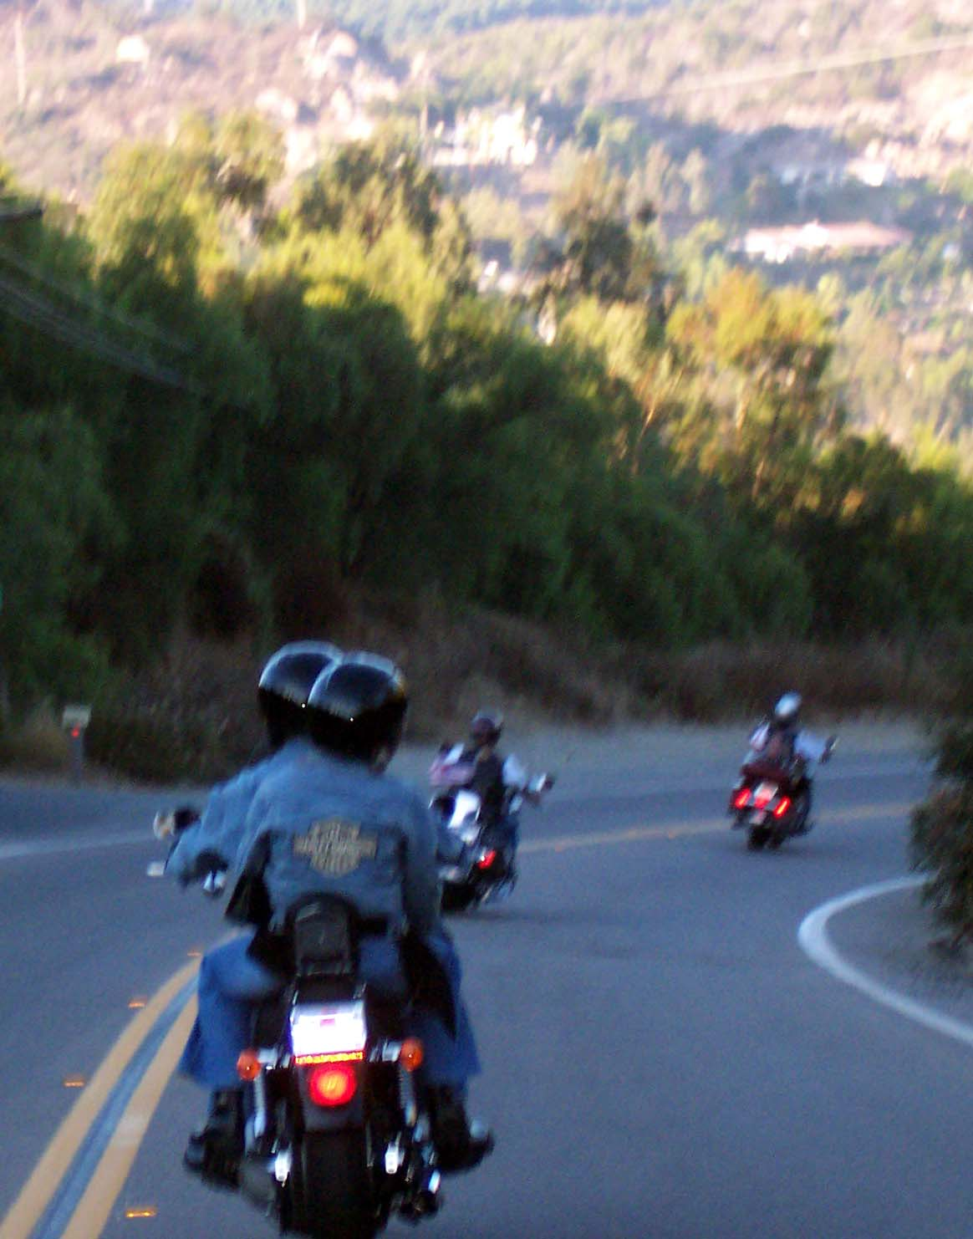
Thank You
Accident Management

