Slide 1
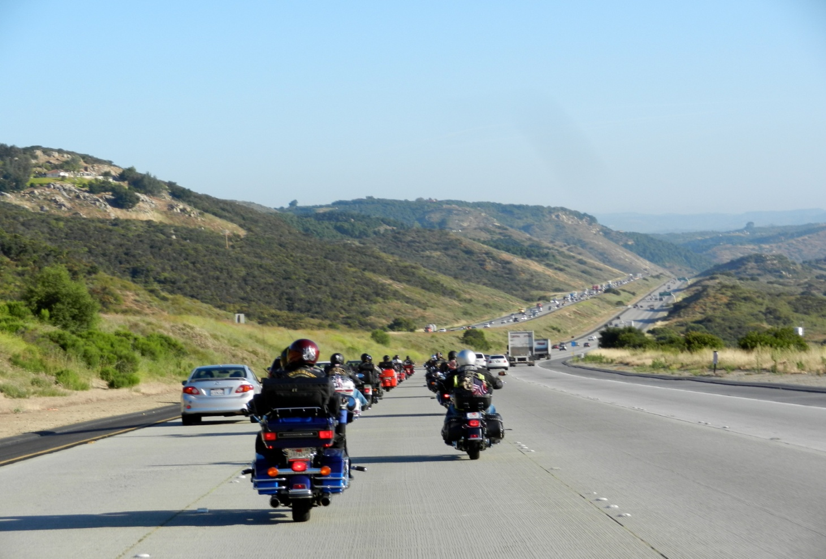
Formation Riding 101
Biggs Chapter North San Diego County H.O.G.
Biggs Chapter
North San Diego County
Harley Owners Group
P.O. Box 610
San Marcos, CA 92079
Website: BiggsHOG.com
Ride Line: 760-736-2920

Slide 2





Formation Riding 101
Sign Roster
Grab a doughnut and cup of coffee
Silence cell phones
Get your “Rider” pin at end of class

Slide 3
A word about trikes, sidecars, trailers…
Everything in this presentation applies equally to riders of trikes, motorcycles with sidecars, and motorcycles with trailers.
Riders of such motorcycles may position themselves anywhere in a group.
Riders of such motorcycles, due to their width, may want to stagger themselves sufficiently so as to avoid being adjacent to another such motorcycle at a stop sign or light.

Slide 4
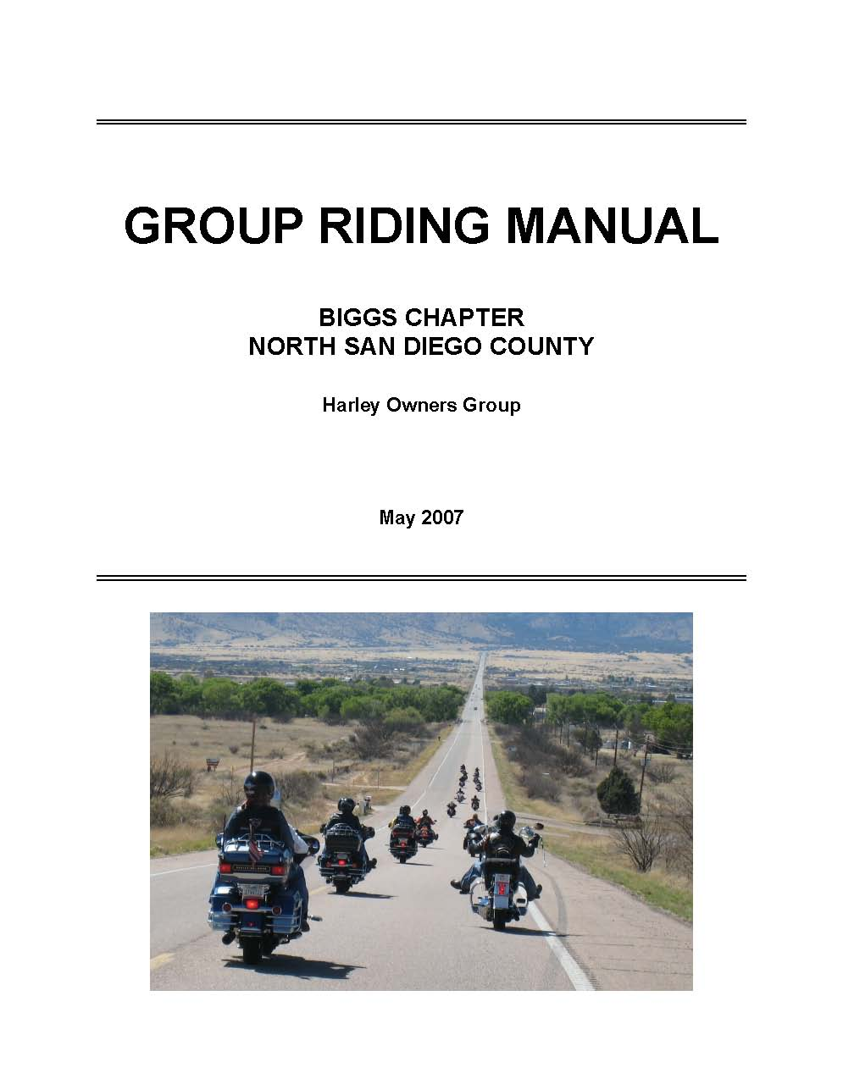
Group Riding Manual
BiggsHOG.com
Members Only Area
Please read

Slide 5
Safety
HOG mission: “Ride and have fun.”
Safety has priority.
Safety promotes fun.
Safe group riding is possible when all members of the group understand and follow safe group-riding practices.
Biggs H.O.G believes that F-101 and F-201 increase understanding of our safe group-riding practices.

Slide 6
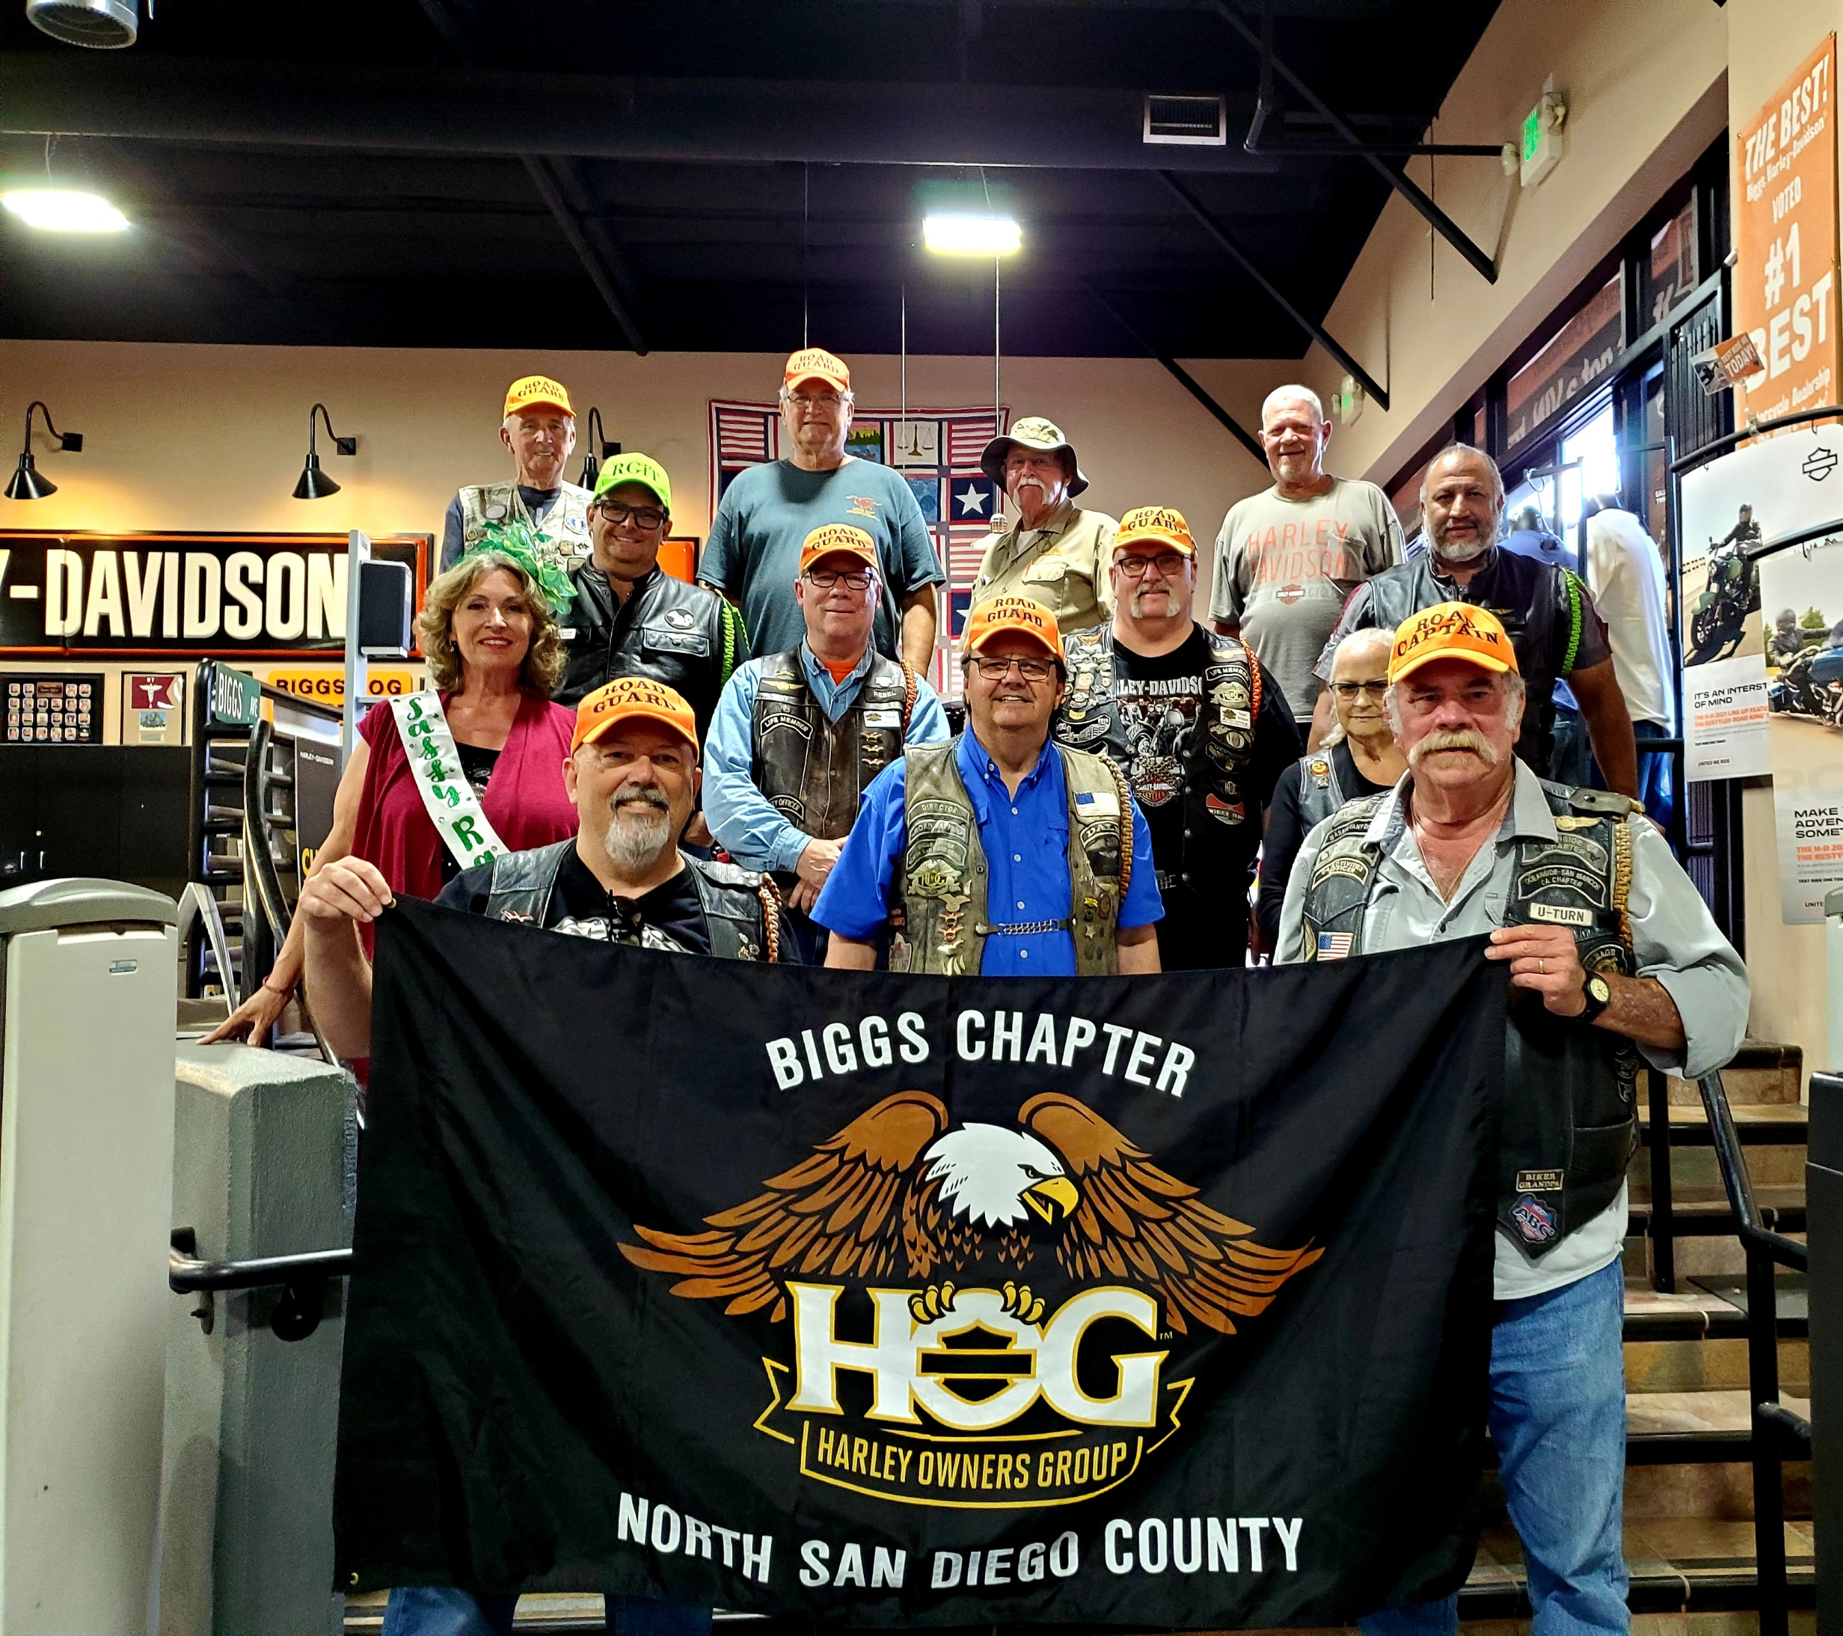
Biggs H.O.G. Road Guards

Slide 7
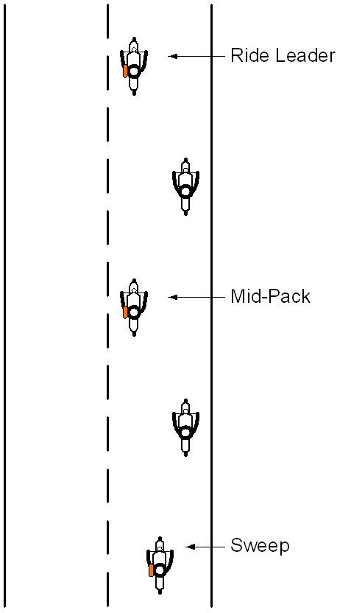
Road Guards
Road Guards
  Conduct the ride
Road Captain
  Manages the Road Guards
  Ensures Road Guards for rides
  Recruits and trains Road Guards
Safety Officer
  Promotes safety in the Chapter
  Facilitates safety education
  Supports Road Guard Program
Formation 101
Biggs Chapter North San Diego County H.O.G.
7

Slide 8
Expectations
Riders are expected to know how to ride.
Riders are expected to have concern for themselves and their fellow riders.
Group Riding implies that we are not simply solo individuals riding together; we are in a group relationship and want everyone to have fun!
Ask the riders behind you, Is it comfortable riding behind me?

Slide 9
Abandoned Riders
There will be NO abandoned riders.
Sweep Road Guard will not pass you.
Let a Road Guard know if you plan to leave the group.

Slide 10
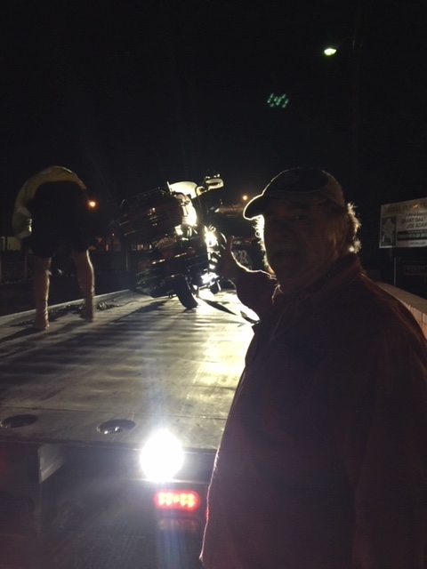
No Abandoned Riders

Slide 11

Alcohol Policy
No Alcohol before or during a Chapter event
National HOG policy
Chapter and Sponsoring Dealership policy
Alcohol voids our liability insurance. There will be no abandoned riders… with one exception…
Applies with equal force to passengers!
…
You may not ride with us if you have been drinking alcohol.

Slide 12
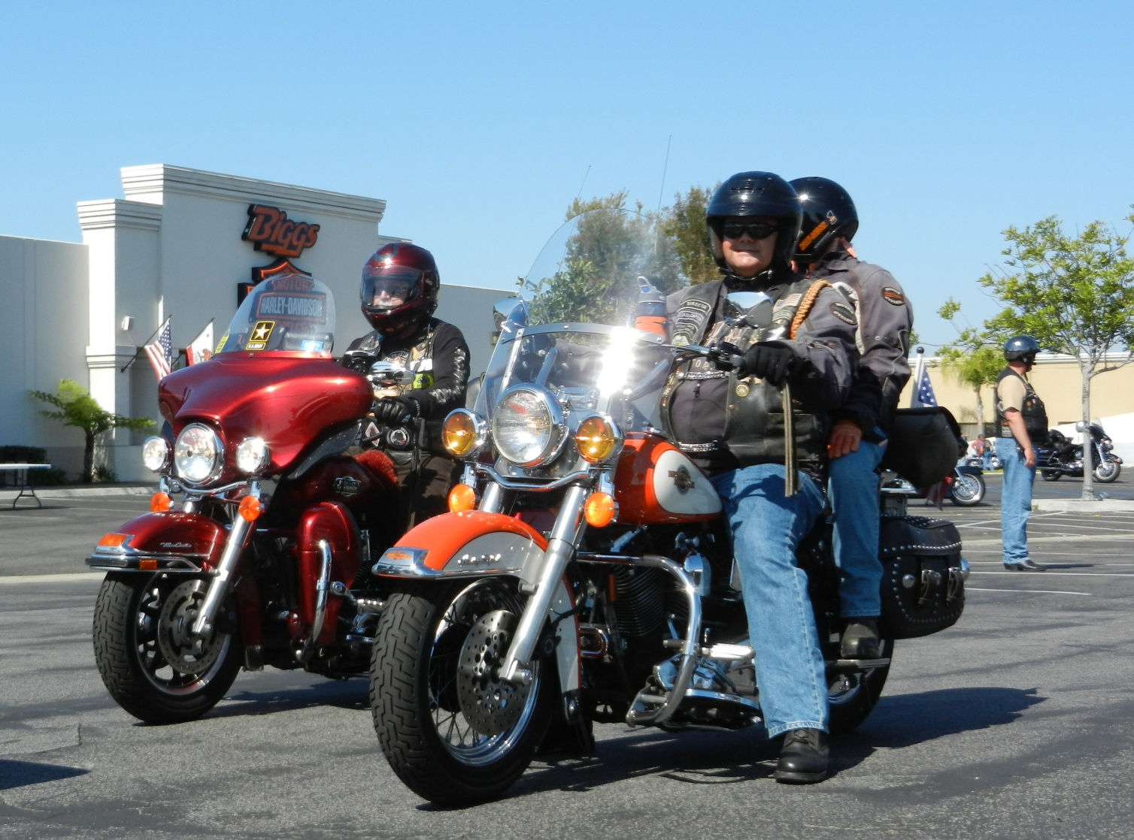
Before the ride

Slide 13
Pre-Ride Checks - Bike
Check before you leave home
T - C L O C K
  T = Tires & Wheels
  C = Cables & Controls
  L = Lights & Switches
  O = Oil & Fuel
  C = Chain & Chassis
  K = Kick (Side) Stand

Slide 14
Pre-Ride Checks - You
Are you ready and fit to ride?
Are you well, no hangover, no alcohol or drug influence?
Enough sleep?
Proper clothing?
Got Water?

Slide 15
Simple Stuff
Show up in time to listen to the pre-ride brief.
Show up with a full tank of gas.
Show up with an empty bladder.

Slide 16
Waivers
Non-members must sign waivers.
Minors must sign waivers.
  Must be signed by parent or guardian
Spouses are not automatically members.

Slide 17
Pre-Ride Briefing
Formation 101
Biggs Chapter North San Diego County H.O.G.
17
Identify the Road Guards
Review safety topics and hand signals
Review route
You may have heard it all before. Be patient. Give your full attention.
Ask questions. Make sure you have all the information.
Tell a Road Guard about your concerns, limitations, and speed restrictions.

Slide 18
Riders New to the Chapter
Riders with Speed Restrictions
Rides will be conducted to the level of the rider with the greatest limitation.
If required, a Road Guard may form a special ride group with the limited rider.
We ask riders new to the Chapter to ride at the front behind the Ride Leader because:
  You will ride slower.
  You are less likely to be separated from the Ride Leader in a split group.
  The Ride Leader can better judge the appropriate pace.

Slide 19
Forming Up to Depart
Pick a group and a place within that group.
Remember, those inexperienced in group riding will appreciate being closer to the front.
Ask a road guard for assistance if needed.
Road guards may ask riders to change groups in order to balance group size.

Slide 20
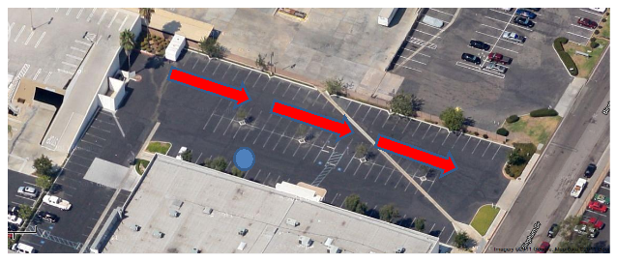
Forming Up to Depart

Slide 21
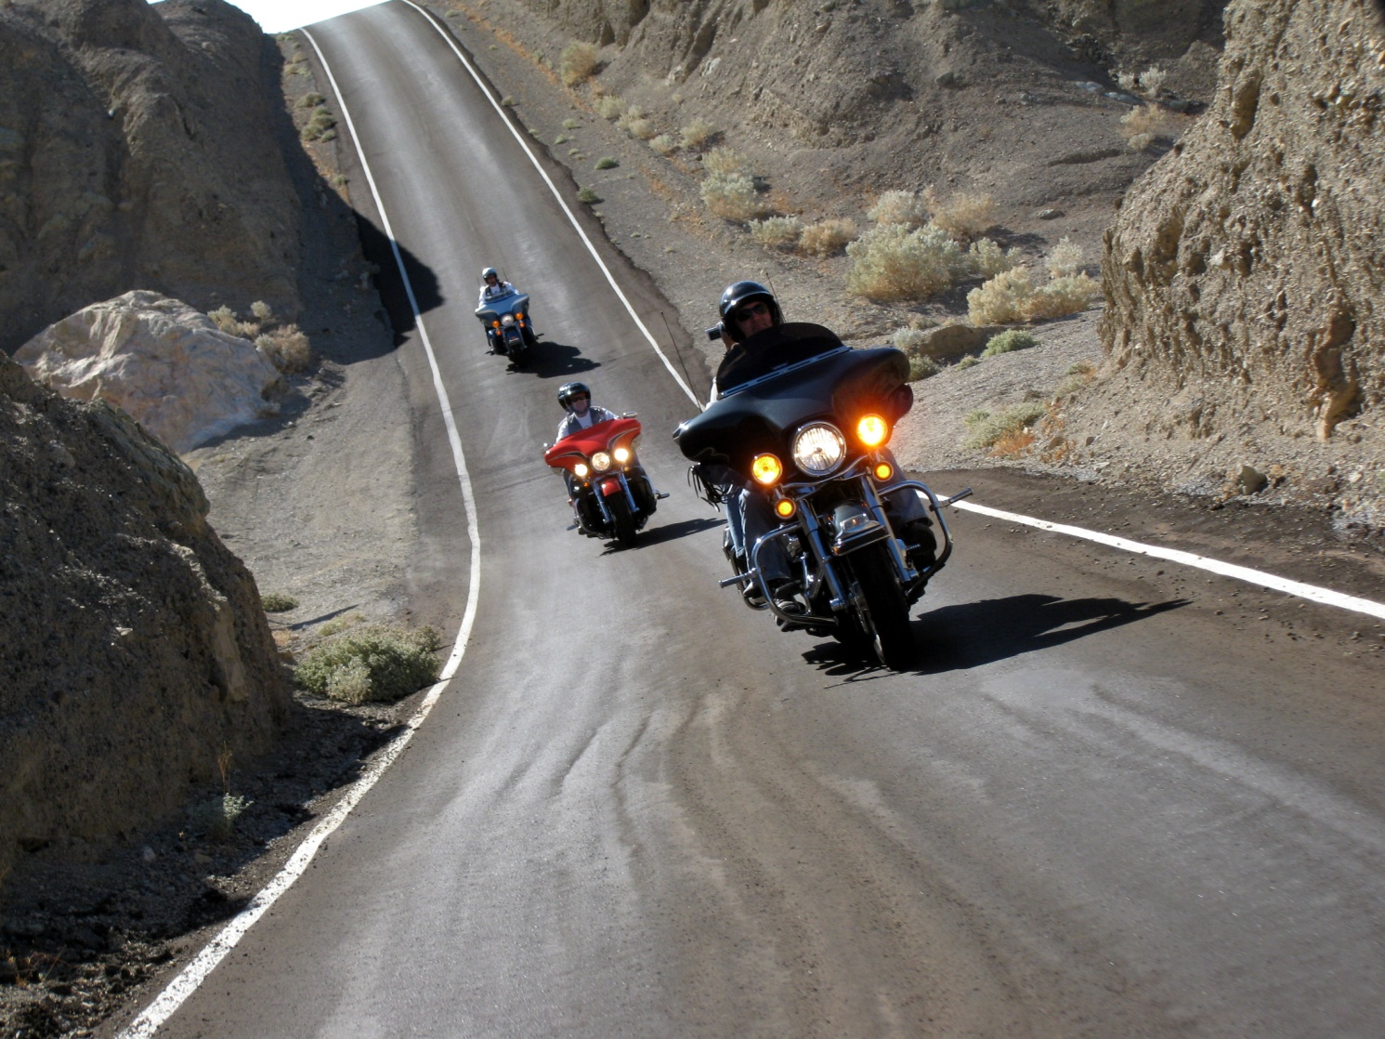
Formation Riding

Slide 22
Own Your Own Safety
Although you are part of a group, you are also an individual and the sole operator of your bike.
You must take responsibility for your safe riding as part of a group.
Never allow yourself to be pressured into doing something unsafe or that makes you uncomfortable.

Slide 23
Your Comfort Zone
If you are not comfortable, why?
  Usually you should fix it.
If pressured or uncomfortable, pull out and take a position in front of the Sweep. Sweep will ride at your comfort level and appreciate your good judgment.
Don’t be bashful about telling a Road Guard of your problems.

Slide 24
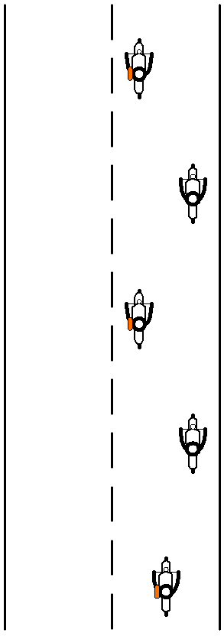
Stagger Formation
Biggs H.O.G. standard riding formation
Ride in the center of the left or right half of the lane
Compacts the group without decreasing the distance from the rider in front
Provides a “way out” by changing lane sides in an emergency.

Slide 25
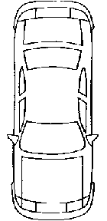
Side-by-Side Formation
Riding side-by-side leaves no “way out.”
WE NEVER RIDE SIDE-BY-SIDE.

Slide 26
Stagger Formation
Using the “way out” by changing lane sides in an emergency.

Slide 27
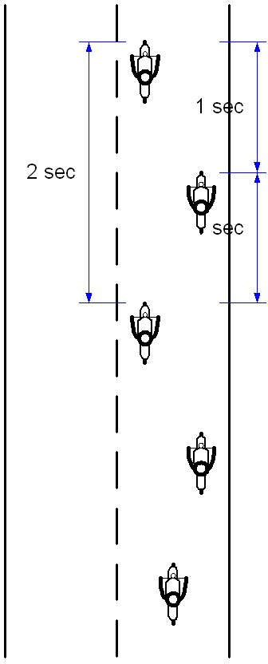
Stagger Formation Spacing

Slide 28
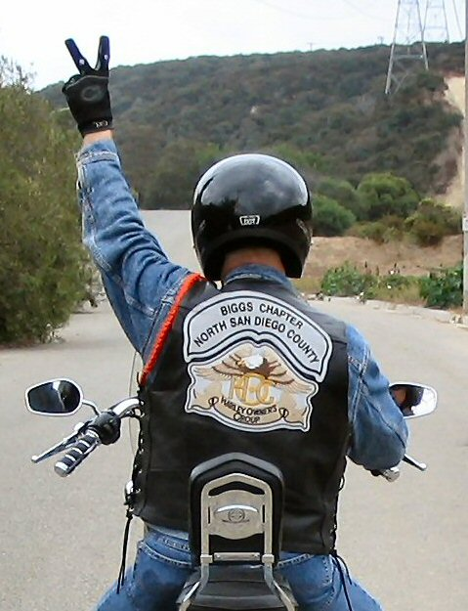
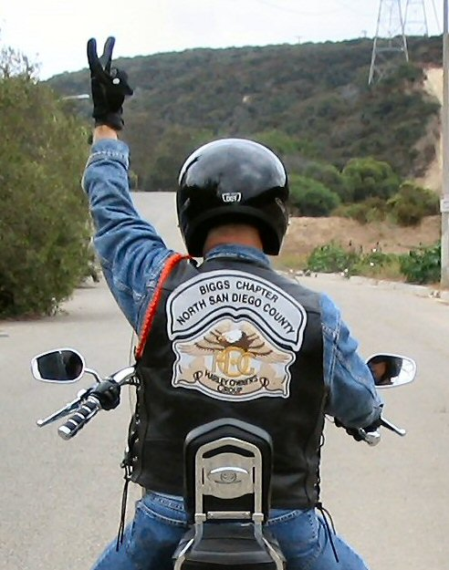
Stagger Signal
Pass hand signal back.

Slide 29
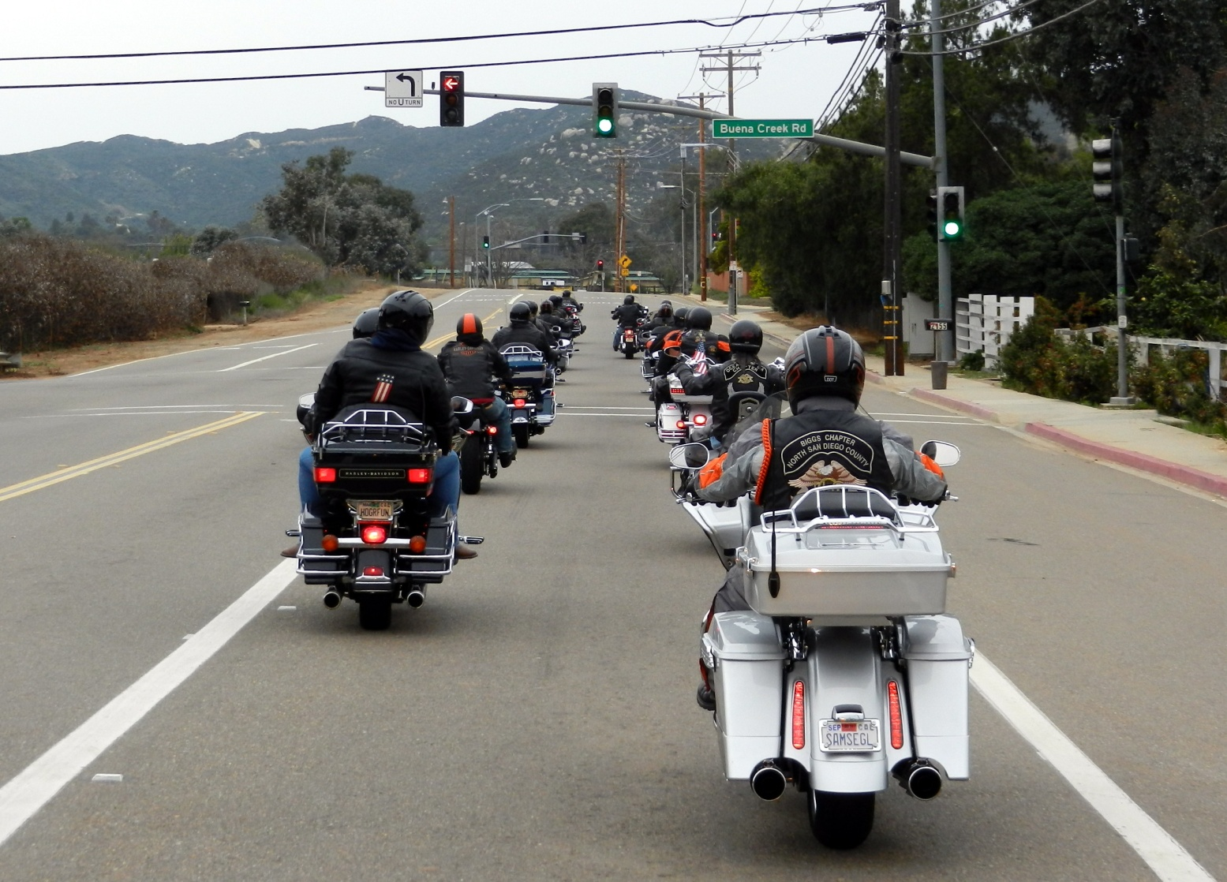
Stagger

Slide 30
Single File
Used on narrow or curvy roads, roads with obstacles or other hazards.
Maintain single file even if conditions change and stagger appears appropriate.
Re-establish stagger after a stop (stop sign or stoplight) unless you are part of a split group, then maintain the formation used before the stop.

Slide 31
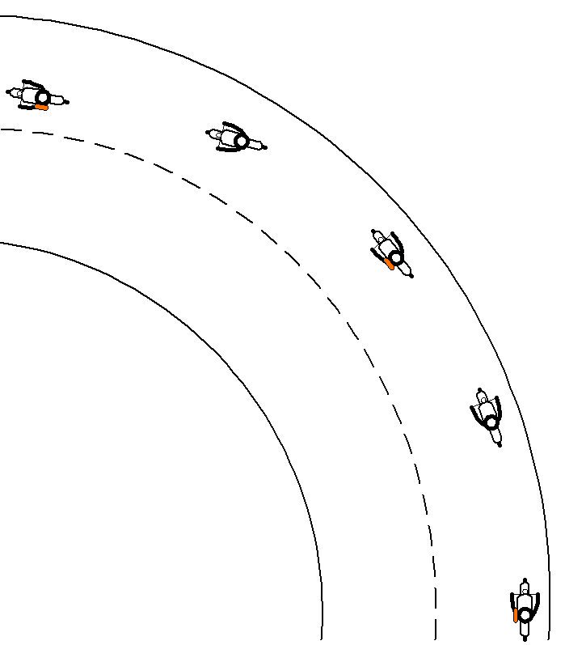
Single File Line
Never make assumptions about road you cannot see.
Use late apex

Slide 32
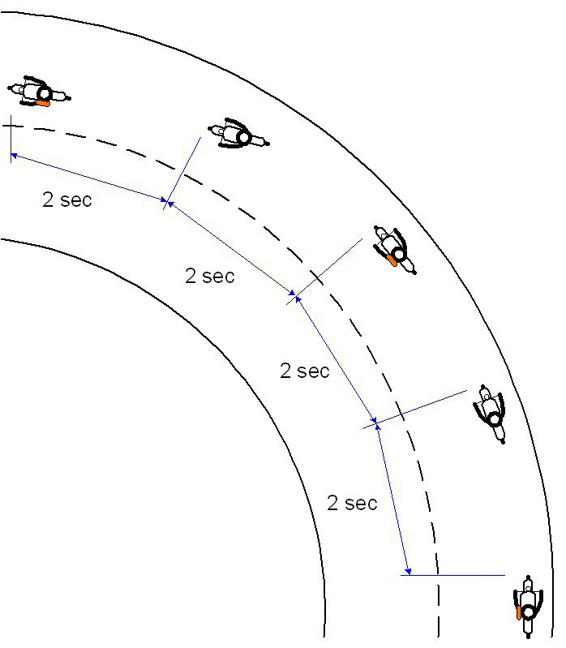
Single File Spacing

Slide 33
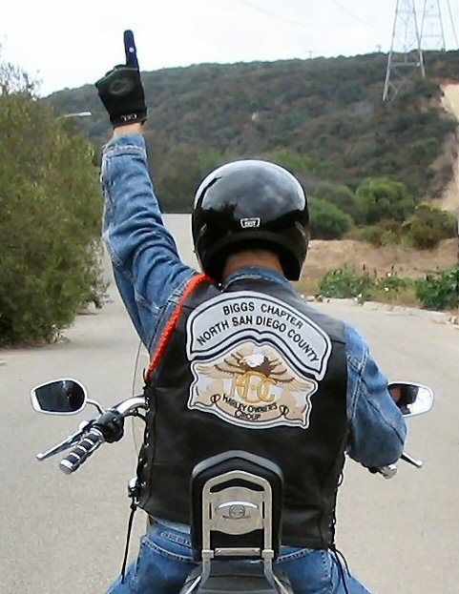
Single File Signal
Pass hand signal back.

Slide 34
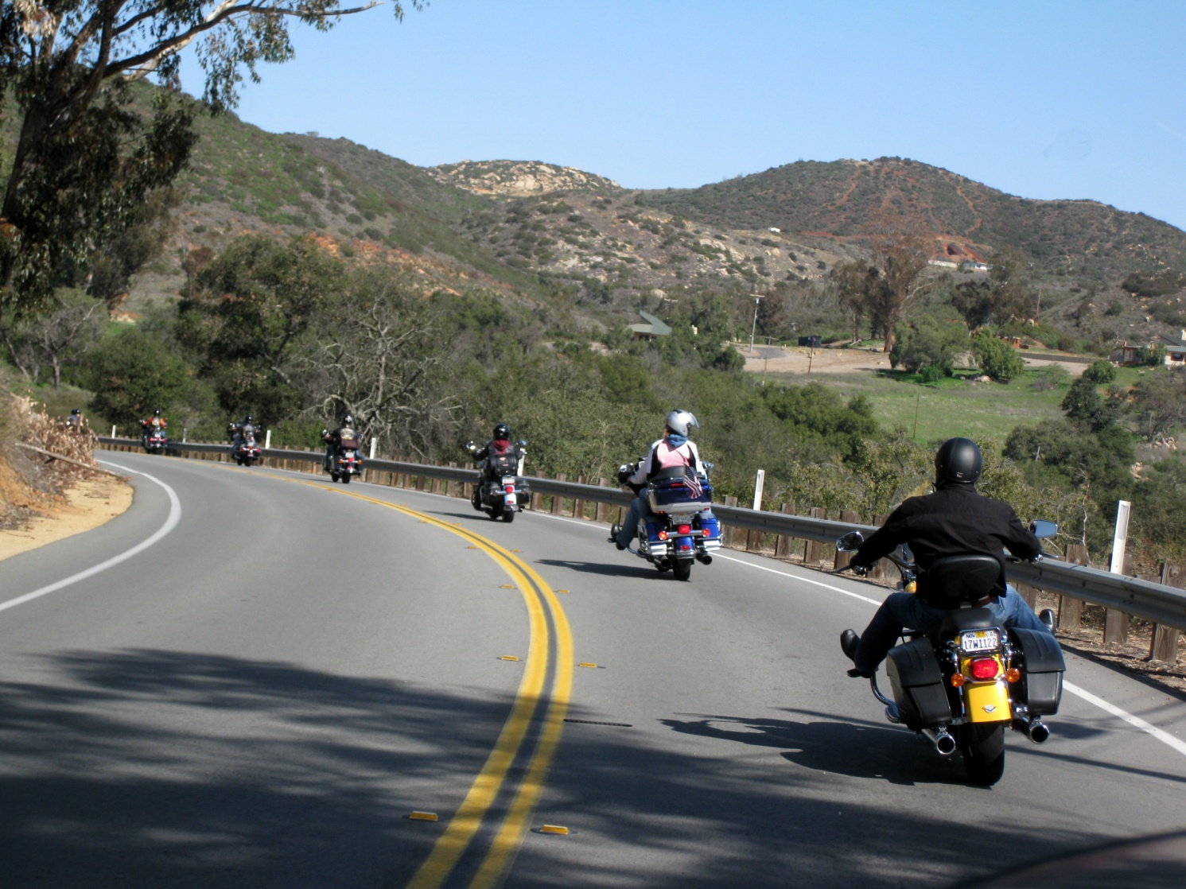
Single File Line

Slide 35
Spacing
In Stagger
  No less than one second from the adjacent bike.
In Stagger and Single File
  No less than two seconds from the bike directly in front.
Maintain position and spacing. Do not rubberband.

Slide 36



Don’t Let This Happen!
I see we have enough room to Dock right there between the two motorcycles….

Slide 37
Other Situations…
Other Hand Signals
Biggs H.O.G. uses various hand signals to pass information throughout the formation.
Be alert for hand signals. Pass forward or back as appropriate.

Slide 38
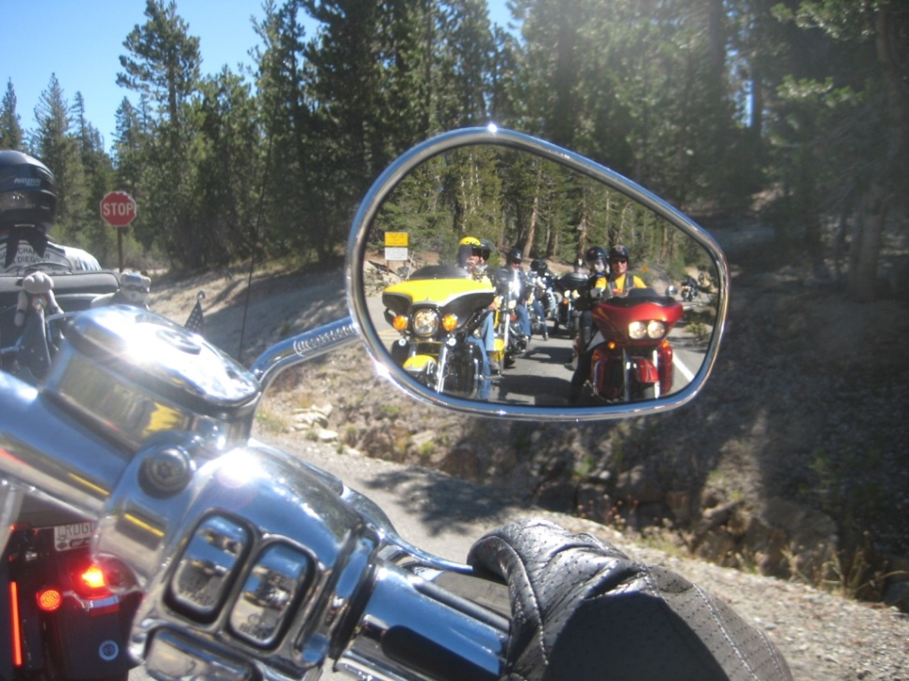
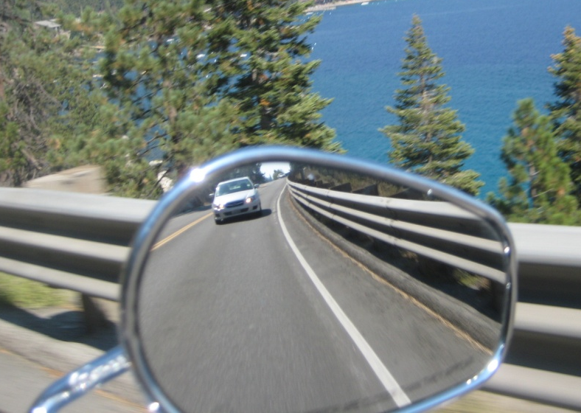
Split Group or Lost Rider
Watch your mirrors, especially after stoplights or turns at an intersection
That is when a group is most likely to get split

Slide 39
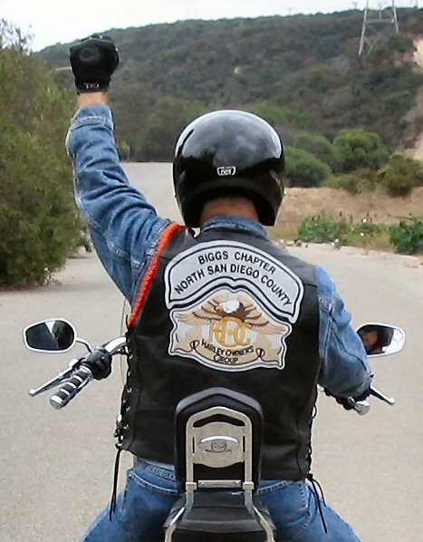
Split Group or Lost Rider
When the group is split, OR we have lost a rider:
Signal the riders in front by raising the left arm straight up with the hand in a fist.
Leader acknowledges with the same signal.
Leader will take action to reform the group.
A group broken up by cars, but in sight, is not split.
Pass signal forward.

Slide 40
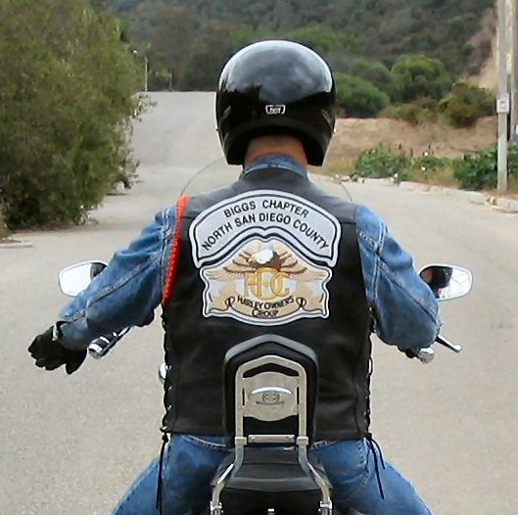
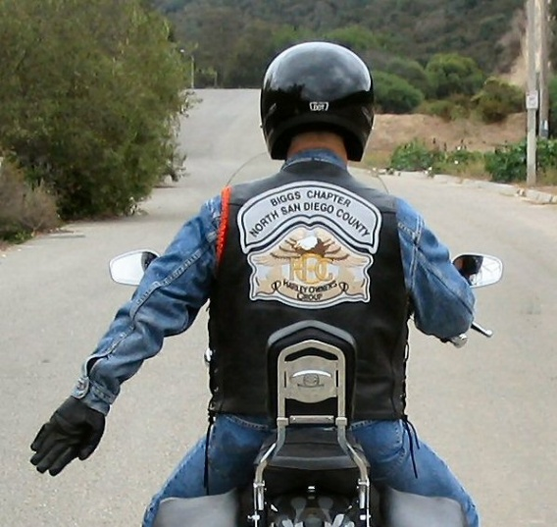
Need More Space?
Possibly because of inexperience, road conditions, bike's handling, or crowding from the rear.
Signal with left arm down waving hand rearward.
Riders behind should drop back.

Slide 41
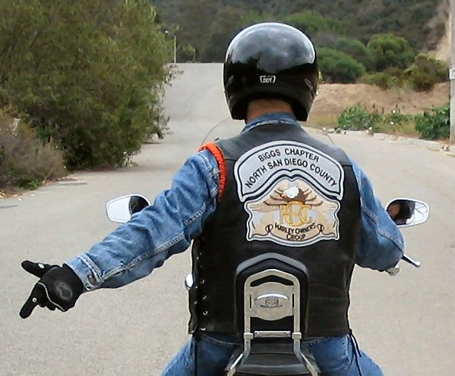
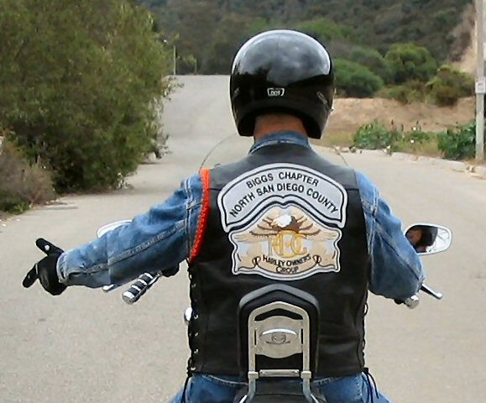
Need to Drop Back or Stop?
A rider may drop out and take up a position in front of the Sweep.
Pull out and wave riders past or just wave riders past, safely.
Sweep will stay with you.
Worst case, slow gently and safely then pull off the road and stop.

Slide 42
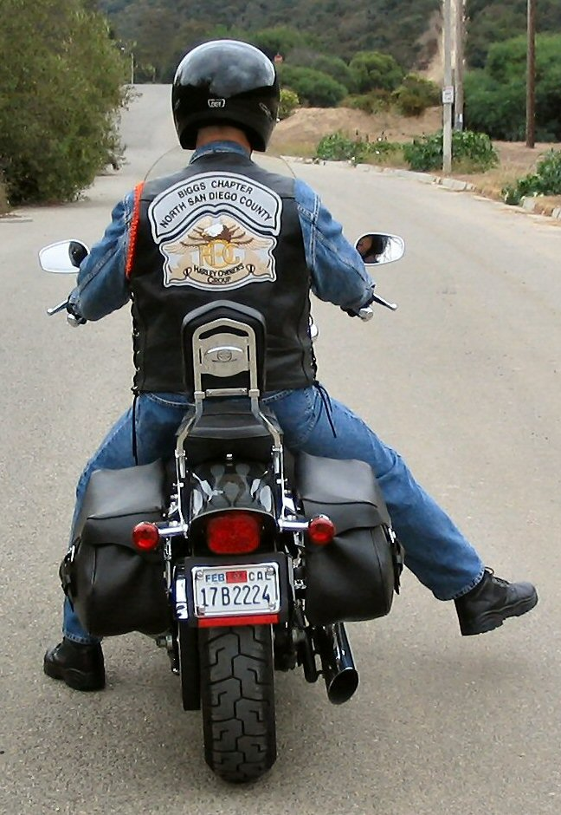
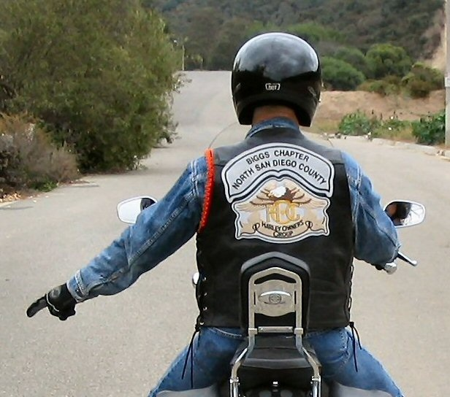
Road Hazards
Point to it so the rider behind sees the problem:
  Left hand
  Left or right foot
Pass signal back.

Slide 43
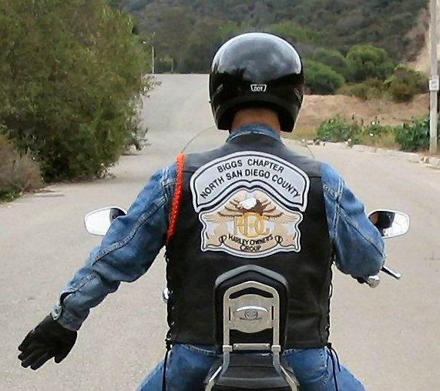
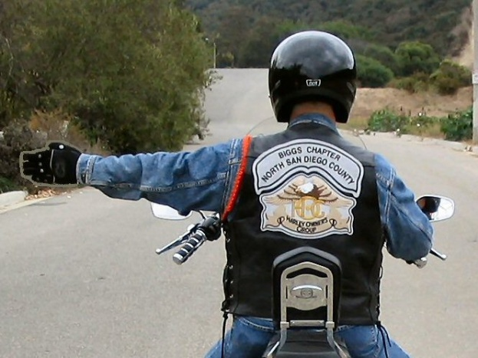
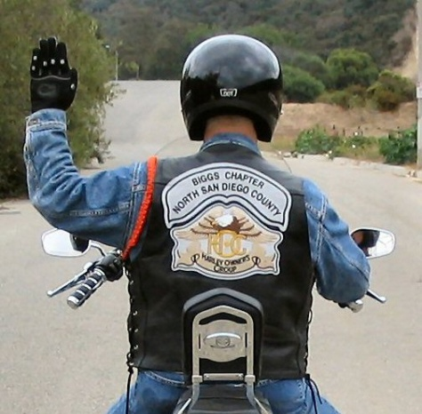
Standard Signals
Standard California hand signals, plus Chapter signals are used.
Pass signal back.

Slide 44
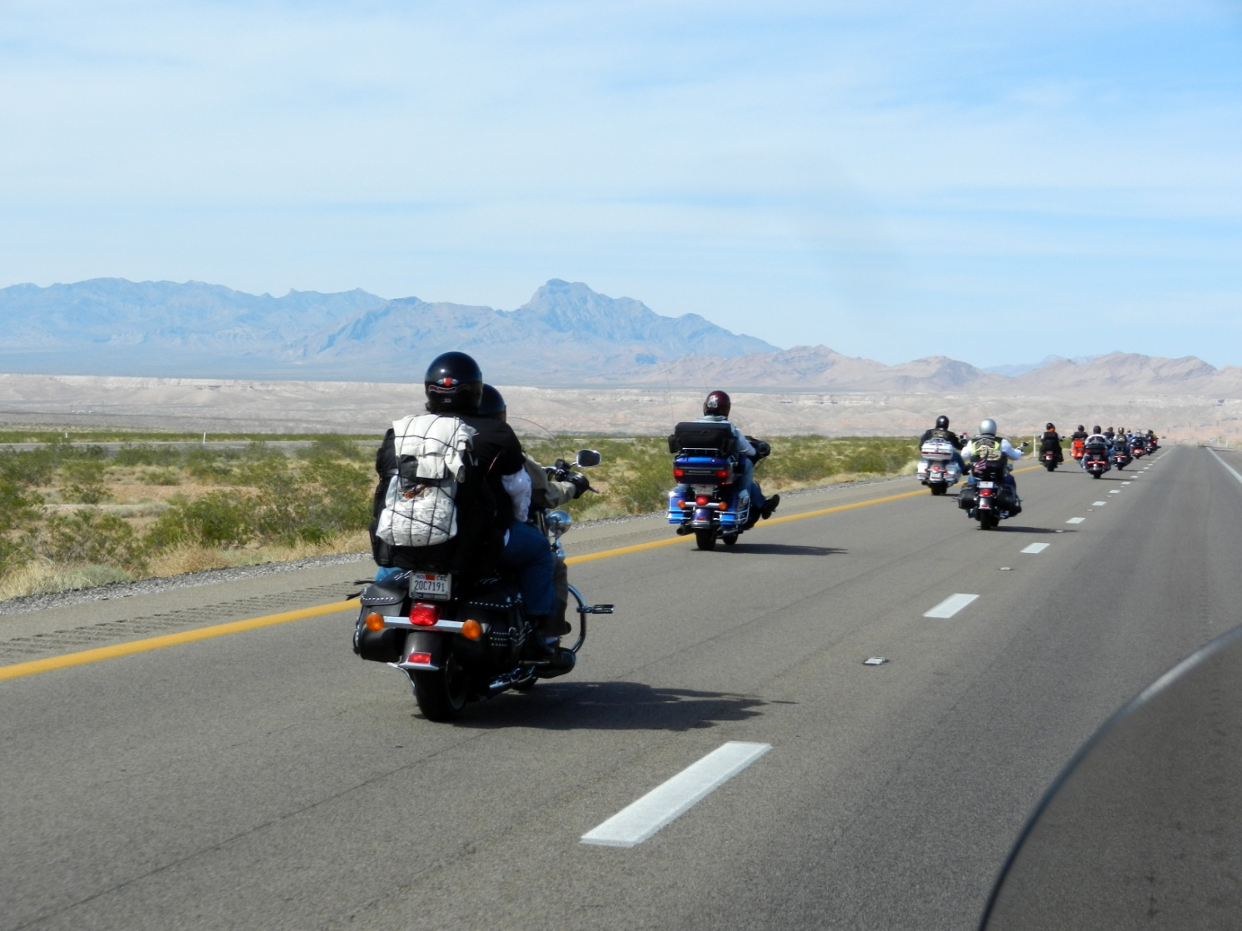
Standard Maneuvers

Slide 45
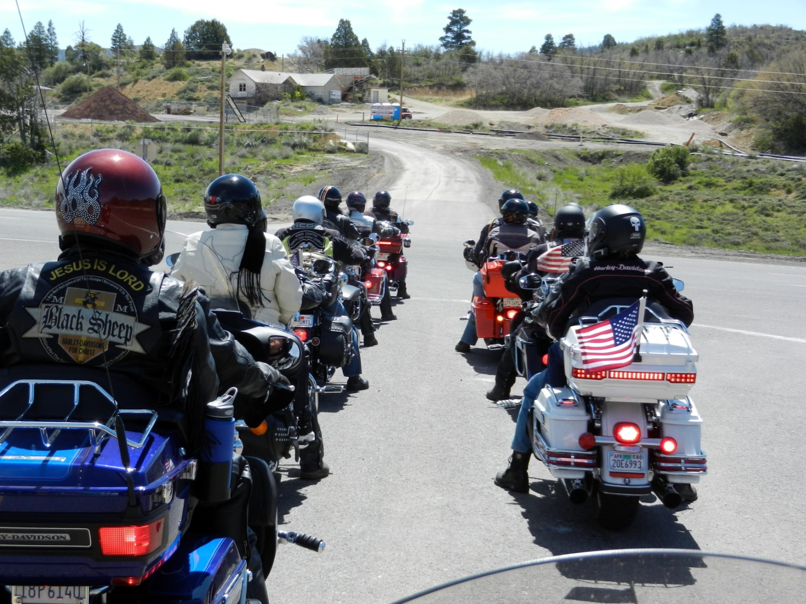
Stop Signs and Red Lights

Slide 46
Stop Signs and Red Lights
Pull up two-by-two.
Don’t block the center of the lane
  So the Ride Leader can see the Sweep
Ensure it is safe to proceed.
Take off together and immediately reestablish stagger.

Slide 47
Approaching a Stop Sign or Stop Light From Stagger Position

Slide 48
Approaching a Stop Sign or Stop Light From Single File Position

Slide 49
Leaving From A Stop Light

Slide 50
Modified Stagger for Passing Large Trucks, Either Direction
When approaching a large truck, from either direction, the bikes nearest the truck give a quick hand or leg signal and move laterally away from the truck, then back to resume position after passing truck.
Move only as far as comfortable.
Do not vary speed.

Slide 51

Modified Stagger for Passing Large Trucks, Either Direction
2+ Lanes in Same Direction

Slide 52
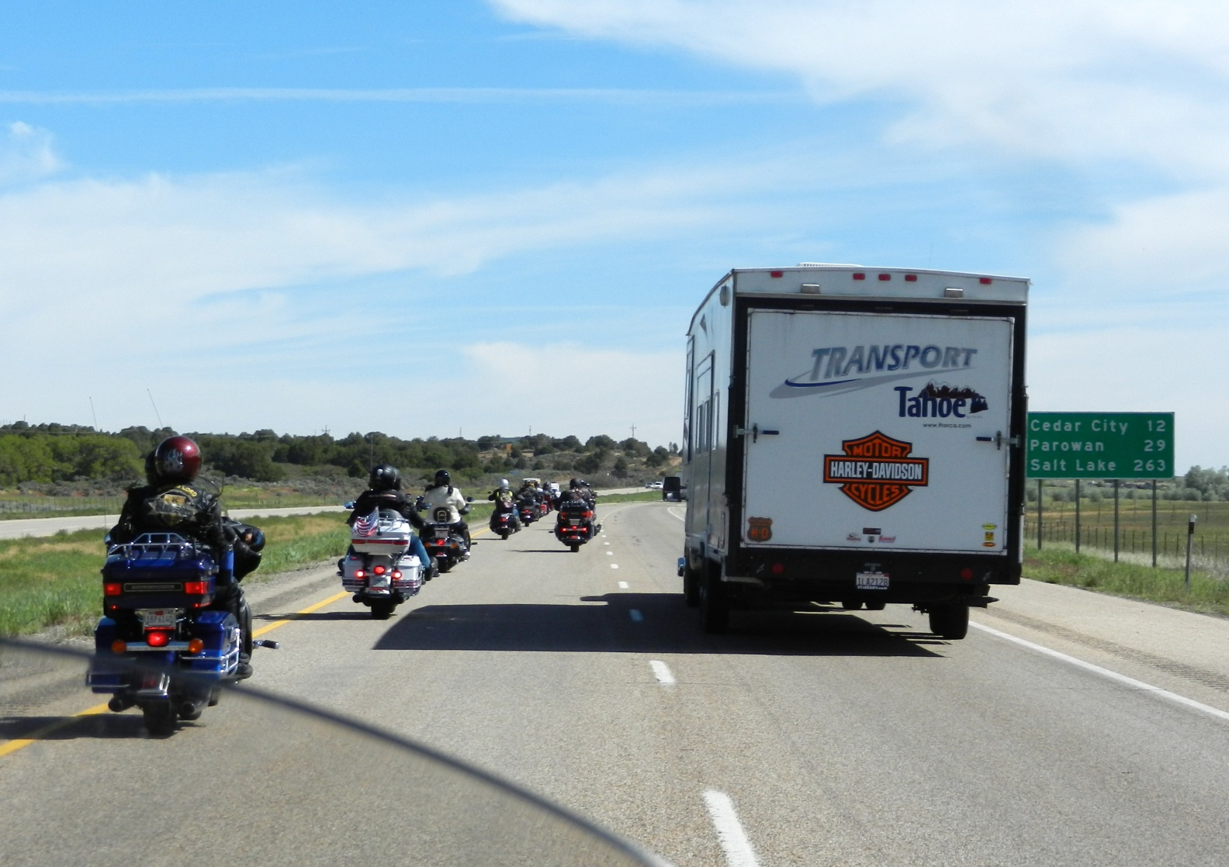
Passing Large Vehicles

Slide 53
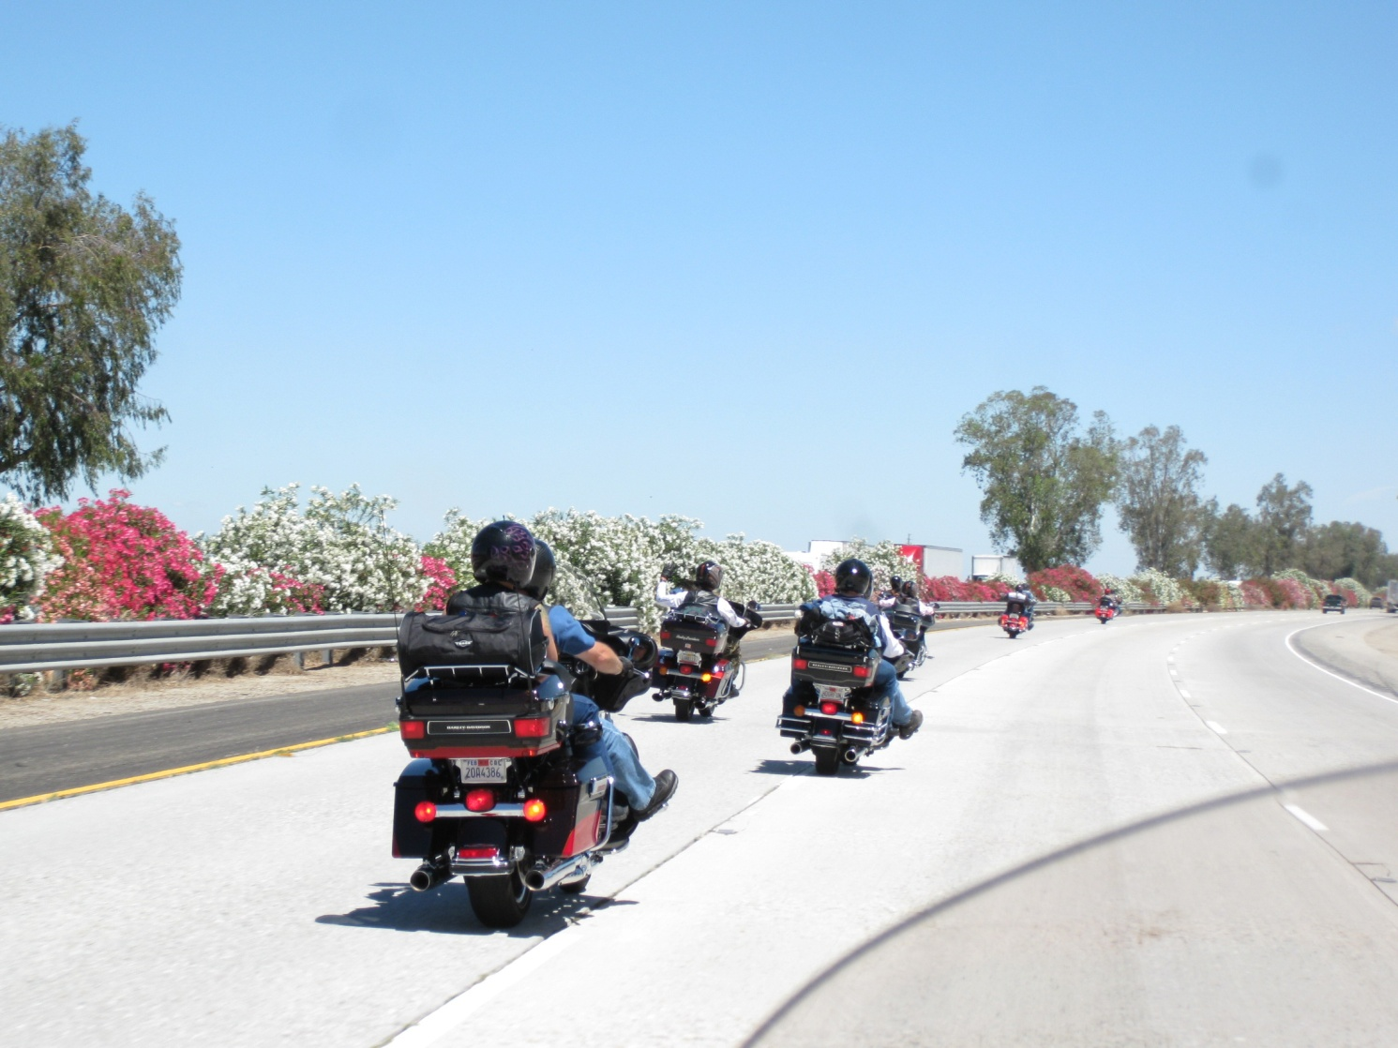
Changing Lanes

Slide 54
Changing Lanes
When signal is given, pass signal back and check mirrors. When bikes behind move, commence lane change.

Slide 55
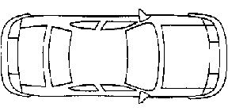
Changing Lanes
When a car is in the next lane, be patient. Don’t trap the car by moving too soon. Allow time for the car to leave.

Slide 56
Changing Lanes
When a car is in the next lane, be patient. Don’t trap the car by moving too soon. Allow time for the car to leave.

Slide 57
Changing Lanes
Note: Only change lanes when signal is passed back from Lead. Do not change lanes solely if Sweep changes lanes if no signal is passed back.

Slide 58
Filling the Gap in Stagger
Check your mirrors.
Each rider (in turn) crosses over and fills the empty space in front in the opposite half of the lane.
If you are not comfortable performing this maneuver, don’t. Hold your position.
We call this the CRISS CROSS…

Slide 59
Filling the Gap in Stagger

Slide 60
Traffic Merging In and Out
Traffic will merge into the group.
They will not like it there and will usually go away the first chance they get.
Let them in; let them out.

Slide 61
Merging onto Interstates
Merge safely
Let the group rejoin as traffic allows.
This is not the standard ‘Lane Change’ procedure.
The careful merge maneuver is also used when entering or exiting the HOV or carpool lane.

Slide 62
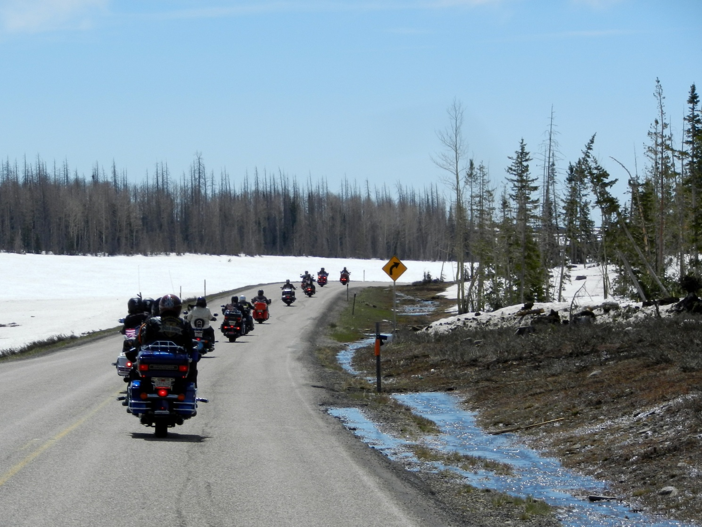
Unusual Situations

Slide 63
Entering a Moving Group
Riders enter ahead of the Sweep(s).
Road Guards may enter anywhere.
  Let them in.
  May create a gap, use gap filling procedure.

Slide 64
Intersections
Clear the intersection - Traffic signals provide no physical barrier to traffic.
We do not turn right on red lights.

Slide 65
Parked Cars
Rides usually stay away from the curb lane if there are parked cars.
Helps avoid opening car doors, and people and animals darting out.

Slide 66
So Now You Are A
Ride Leader
Traffic lights and traffic conditions will often break up the group.
You may be the leader.
Carry on just as you have been.
The group ahead will take action so your group can catch up.
A Road Guard may take over the lead.
RELAX!!!

Slide 67
Suddenly You're at
Laguna Seca
Other bikes may overtake the group from the rear, often aggressively.
Move to the right, allow the faster rider to pass safely.
Watch Your Mirrors!

Slide 68
Major Roadside Emergencies
May be internal or external to the group.
Keep your head, use good judgment.
If you can help, do so; otherwise, stay out of the way.
Look to Road Guards for guidance.

Slide 69
Parking
Plan ahead.
Make sure you can get out unassisted.
Don’t leave Sweep in the street!

Slide 70
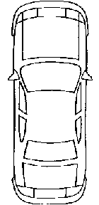
Watch this guy.

Slide 72
Other Group Riding
Courtesy Tips
Do NOT use Cruise Control in the group
Be respectful to the others in your group, and don’t rap your pipes. Keep speaker volume down.
Ask before smoking in front of others; NO SMOKING during meetings or around bikes!
Stay in your part of the lane when in staggered formation
Try not to rubber band, gap, or drift!
Keep your bike in first gear at stop lights
  It allows for quick emergency starts if necessary

Slide 73
Change in Riding Habits
Once you become accustomed to riding with Biggs H.O.G., don’t be surprised if you find riding with others not quite as comfortable as it used to be.
These riders might:
  Not comply with the two second rule
  Not ride in stagger when appropriate
  Not abstain from alcohol
  Take unreasonable risks
Remember Own Your Own Safety
  If you feel unsafe or uncomfortable stop or leave.

Slide 74
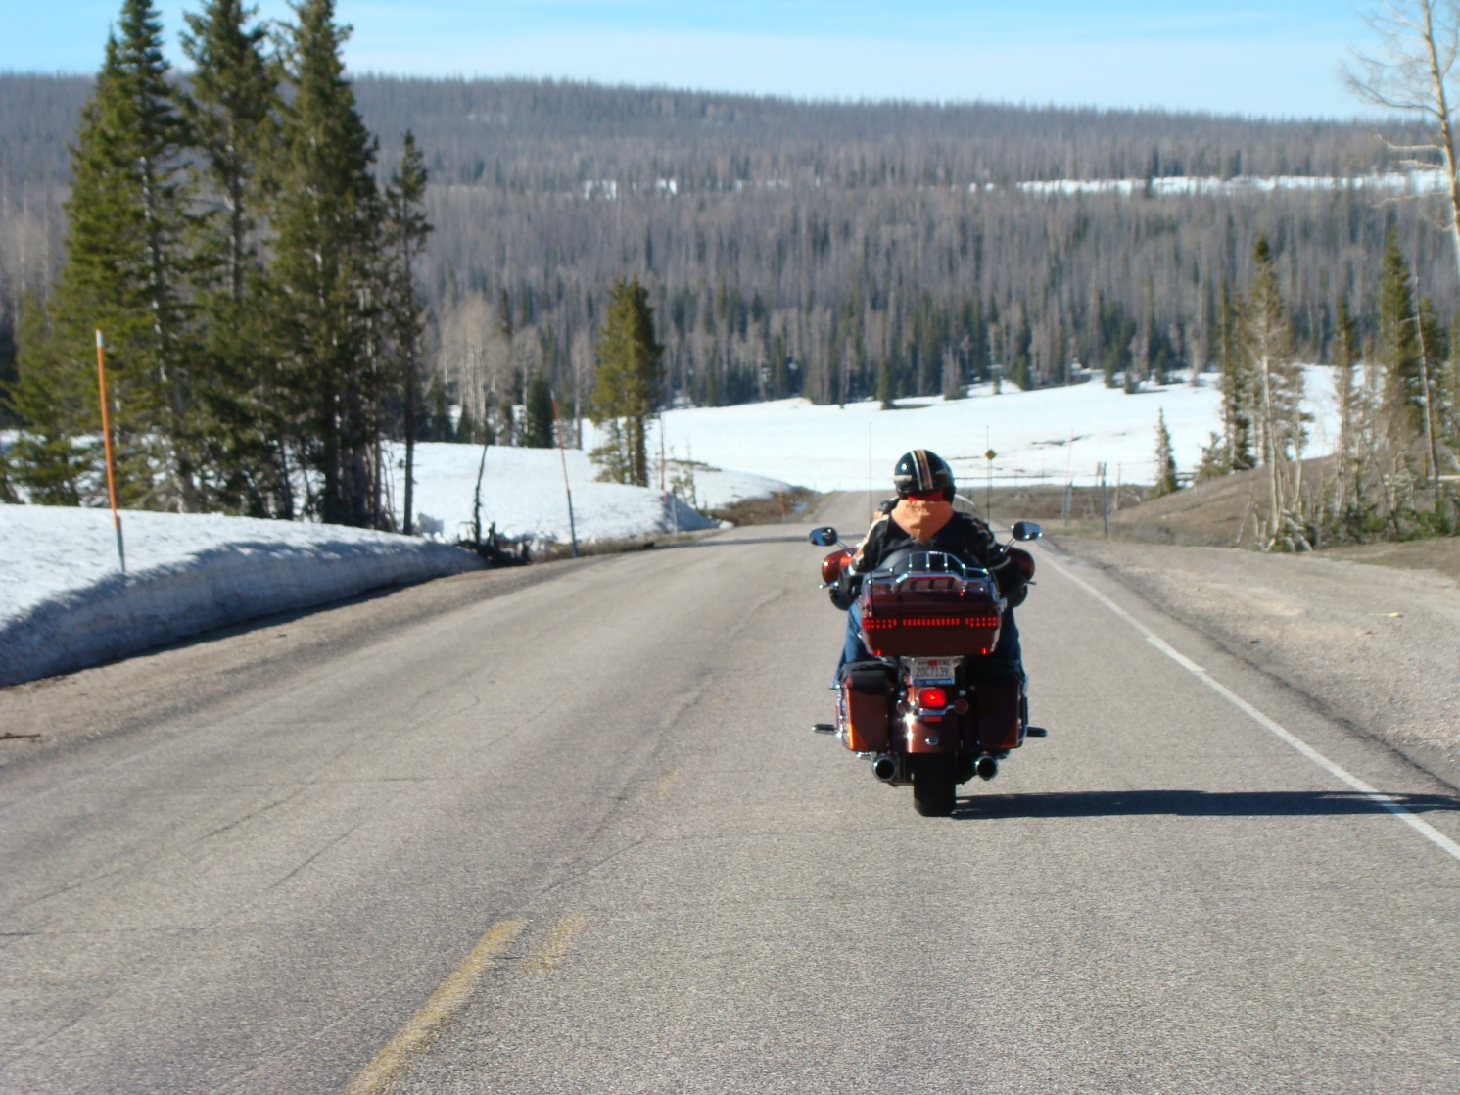
The End - Thank You

