Slide 1
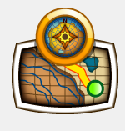
Ride Routing Using Garmin BaseCamp

Slide 2
Garmin BaseCamp disclaimer. Not going to cover all options of BaseCamp just the ones we use most often.

Slide 3
Software Downloads
Garmin Express: https://www.garmin.com/en-US/software/express/
BaseCamp Program:
http://www.garmin.com/en-US/shop/downloads/basecamp
Google Earth v6.2 https://support.google.com/earth/answer/168344?hl=en&ref_topic=2376075&vid=0-125997967830-1490797171186

Slide 4
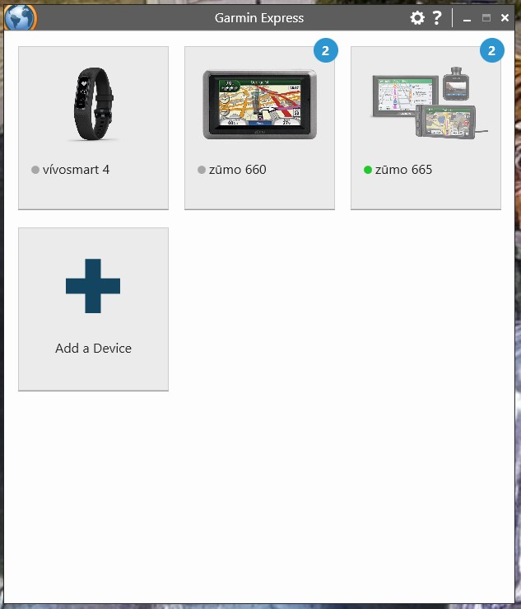
Garmin Express Is used to manage your Garmin devices to install updates and updated maps to your device an/or computer.

Slide 5
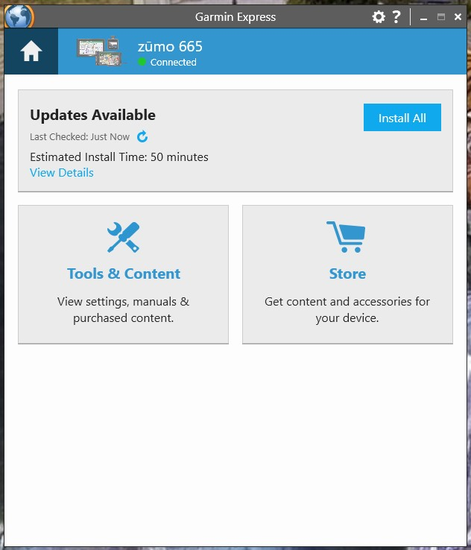
Garmin Express

Slide 6
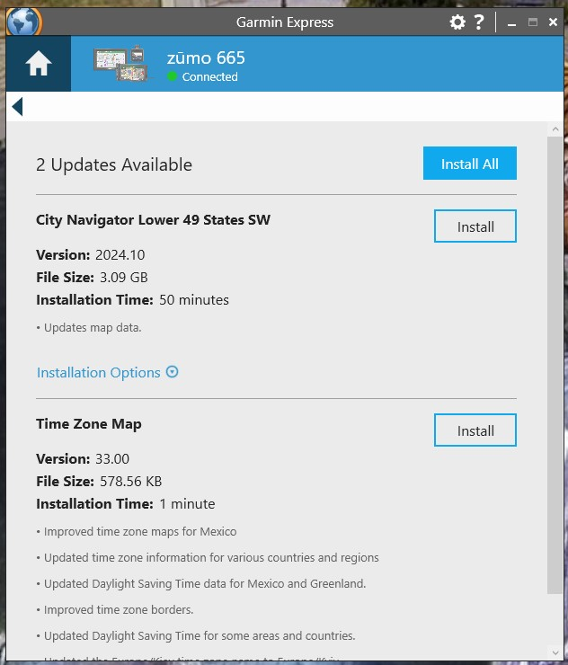
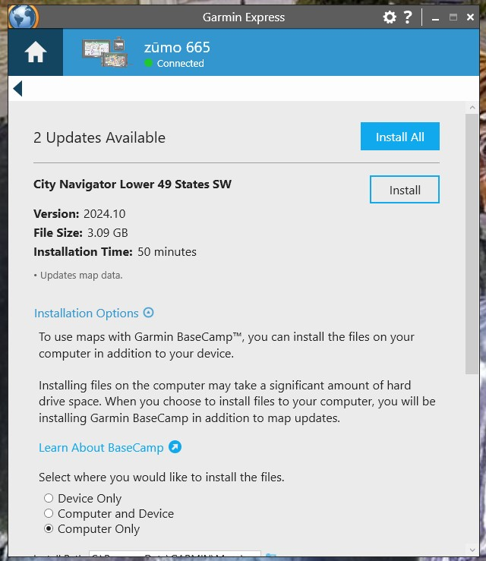
Garmin Express

Slide 7
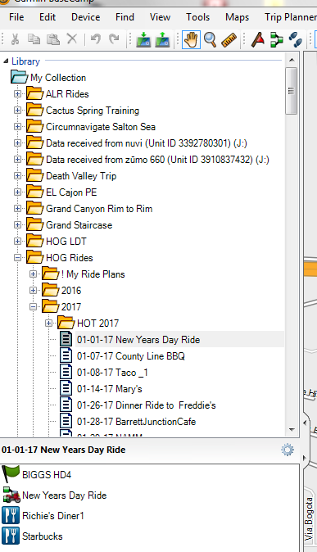
BaseCamp
All items in BaseCamp are contained in “Your Collection” and are available for any route.
A list folder may contain sub-folders which contain one or more lists.
A list contains route(s) and waypoint(s)
In the example to the right the route “New Years Day Ride” is contained in the following;
My Collection <- Contains everything!
HOG Rides <- Folder for all HOG rides.
2017 <- Folder for 2017 rides.
01-01-17 New Years Day Ride <- A list.
(Note that the bottom pane contains all the items from the item that has focus in the top pane.)

Slide 8
BaseCamp Menu Bar
File:
New: Used to create new list folders, lists , routes and waypoints.
Import: This is used to bring items into your collection. The command will read “Import into <where your cursor has focus>. For example, if you have the focus on “My Collection” it will read “Import into My Collection.” If you have focus on the “HOG Rides” folder, it will read “Import into HOG Rides.”
Export: This is how you create a GPX file for distribution. This command works similarly to the import command. It will create a GPX file containing all objects based on where you have focus.

Slide 9
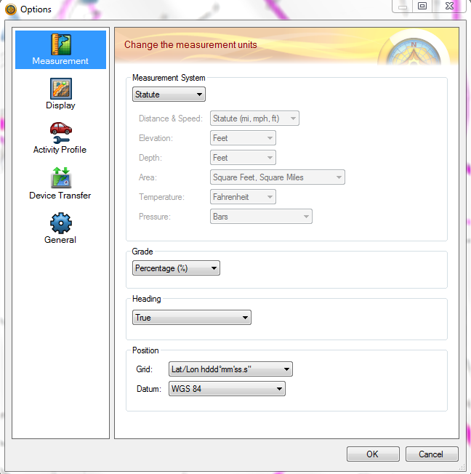
BaseCamp Menu Bar
Edit: This menu item contains your standard options items like cut, copy, paste, delete, duplicate and others. But the one we are most concerned with is “Options”.
This is where we are telling BaseCamp how to route us.

Slide 10
BaseCamp Menu Bar
Device: This allows you to send GPX files to an attached Garmin device and to receive data from a device.
Send to Device: Send to a supported Garmin device such as a Zumo or Navtech.
Receive from Device: Export data from an attached device to BaseCamp.
View: Allows you to sort and organize the way you view items. This menu item also allows you to view a route or selected items in Google Earth.
Maps: Allows you to choose between the global map, installed maps (Garmin Express) or purchased maps.

Slide 11
BaseCamp Speed Buttons
Provides easy access to many of the menu items.
Context Menu: Right click on an item in “My Collection” and menu items appear depending on the item selected. Most commonly used are; send, move, duplicate, remove, rename, new list and new list folder.

Slide 12
Difference Between Copy and Duplicate(Under Edit)
Scenario: You want to leverage an existing route, but you want to change it a little….
Do you “copy” or “duplicate?” the route first?
Copy will create a new route but any changes you make in either will be in reflected in both the new and “copied” route. The routes are linked.
Duplicate will create a new version of the old route, but changes are not linked back to the route you “duplicated.”

Slide 13
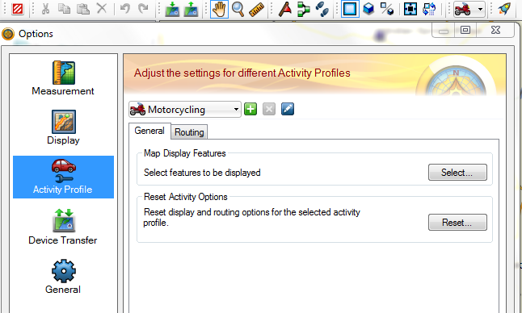
Activity Profiles
Be careful when changing settings for the Motorcycling profile!
Changing the profile too much may cause the route to shape differently on a different computer.

Slide 14
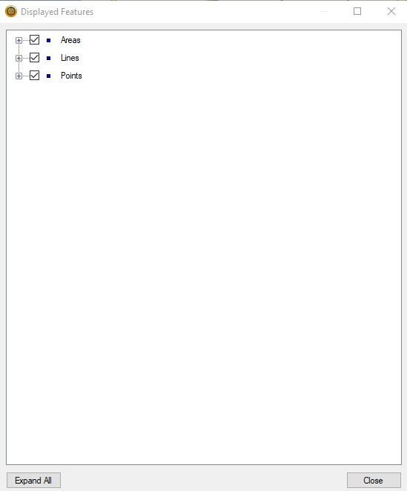
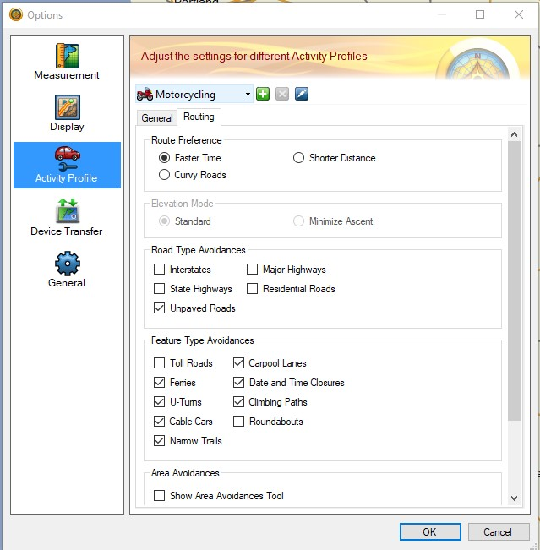
Activity Profiles

Slide 15
Importing GPX Files
Road Captain just sent an email with a route. Now what?
Download the route (file with GPX extension) and save it in a directory or desktop.
In BaseCamp, under “My Collection” set focus on the list folder in which you wish to import the GPX file.
Click the “File” menu item, then “Import into.” Navigate to the file you just downloaded. Select and click “open.”
The GPX file will show up as a list containing routes and waypoints.

Slide 16
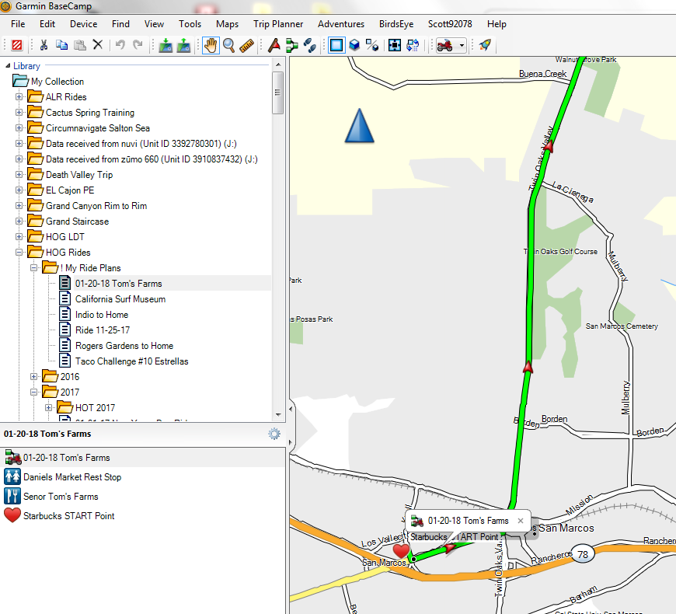
Viewing an Imported Route
To view the imported route, click on the list to see the routes and waypoints contained in the GPX file. Placing focus on the route itself (as shown) allows the route to be opened.

Slide 17
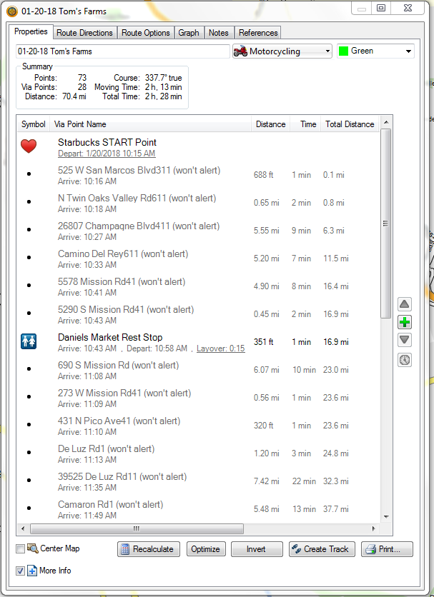
Viewing an Imported Route
Double click on the route in the bottom pane to open the “Properties and Route Directions” box.
Items that are not “grayed out” will alert upon arrival. In the figure to the right only the starting point and the midpoint stop will alert upon arrival.
All the other items will not alert and are “shaping points.” A shaping point “shapes” the route by inserting itself as a point that the route must go through. To Simplify the route directions, set all shaping points except the start, mid stops, and end to “won’t alert”.

Slide 18
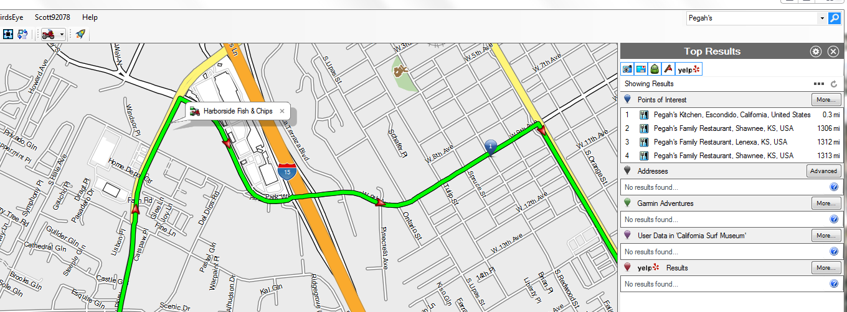
How to Find & Save Points of Interest
You can utilize the search bar in the upper righthand corner by typing in the name of a point of interest. Click on search and then the search pane will open and show the appropriate results.
If the route has focus you can also right click at any point along the route and then click on “Find Nearest Places.”

Slide 19
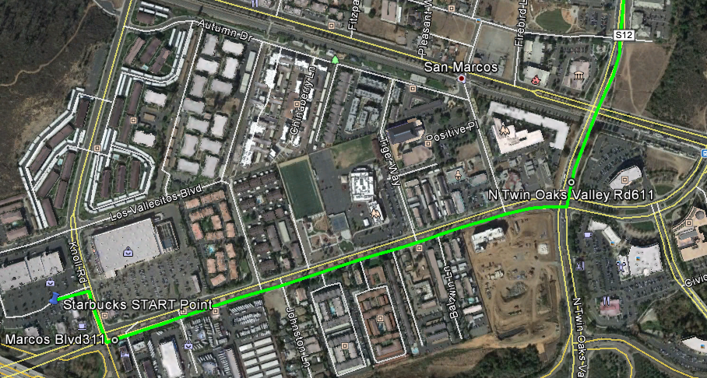
Viewing the Route on Google Earth
Start Google Earth, then navigate to route’s KML file by selecting “File” “Open”. Select the KML file and click “Open” in the lower right corner of box.
Viewing the route on Google Earth is a great tool in identifying lane collapses, troublesome intersections and the best way to get into and out of stops.

Slide 20
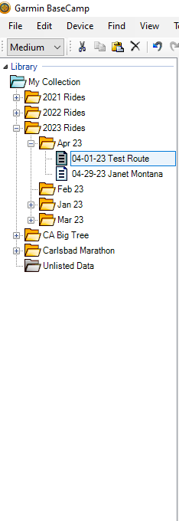
Creating a New Route!
Place focus on the list folder where you want the route to be located, then right click and select “New List.” Name your new list. New route names include the date “mm-dd-yy” and a brief description of the destination.

Slide 21
Creating a Route
Select the new route and add the start and end locations and any mid point stops to make.
There are two ways to do this, one, if these points are already in the collection, you can copy them to the new route. Two, you can select them on the BaseCamp map and create a new waypoint.

Slide 22
Creating a Route
We could just let BaseCamp create the route for us BUT you know that the Biggs route is NEVER the shortest distance between two points!
We always do our routes manually!

Slide 23
Creating a Route
With an idea of the route in your mind, click on Biggs as your starting point, right click and select “begin route”. Your cursor will now change into a pencil and the new route box will open. Click the “X” on the new route box to close it. Use the wheel button to zoom in and out on the view. Use the arrow keys to move around on the map. As you click for turns the route will start to form.
Note: Be careful at this point, if you accidentally click the mouse button on a wrong spot it will route you there. If this happens, use the “ctl + z” to erase last click.

Slide 24
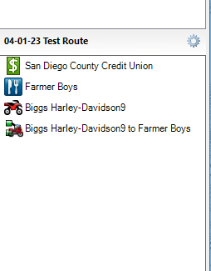
Creating a Route
As you can see, BaseCamp created a route with the name of the start and end waypoints. Select the route and rename it as we did previously. You can’t duplicate the name so what I do is give it the same name but with no spaces in IT “04-01-23TestRoute”.

Slide 25
Creating a Route
To get the ETA for the route, double click on the route to open its property box.
On the properties tab, double click the starting point to open its properties box.
Select the “Departure” check box, the date of the ride and projected departure time. Then click “Ok”. If the times do not change, click the “Recalculate” button at the bottom. Record the arrival time under your destination.

Slide 26
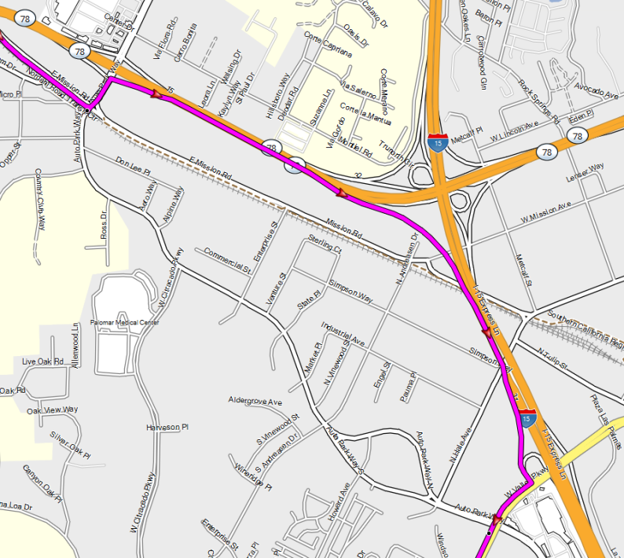
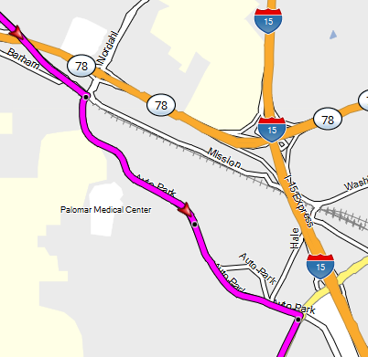
Altering a route
After finishing the route, you may wish to change it. To do so make sure that the route is highlighted and then hold the “alt” key and drag the route to where you want.

Slide 27
Polishing
You can change the information related to any waypoint by double click on it to open its property box.

Slide 28
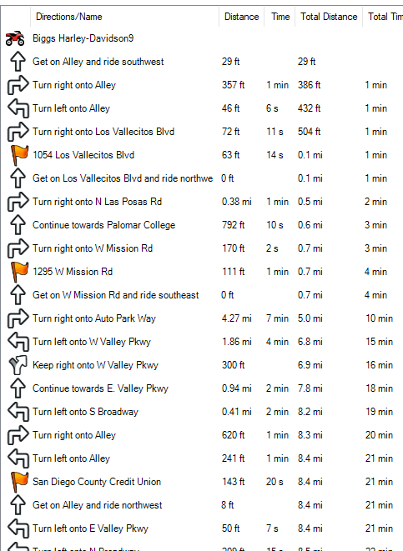
Creating the Spreadsheet
To simplify the spreadsheet, you want eliminate unnecessary information before you export. This is accomplished by setting unnecessary waypoints to “Don’t alert on arrival”.

Slide 29
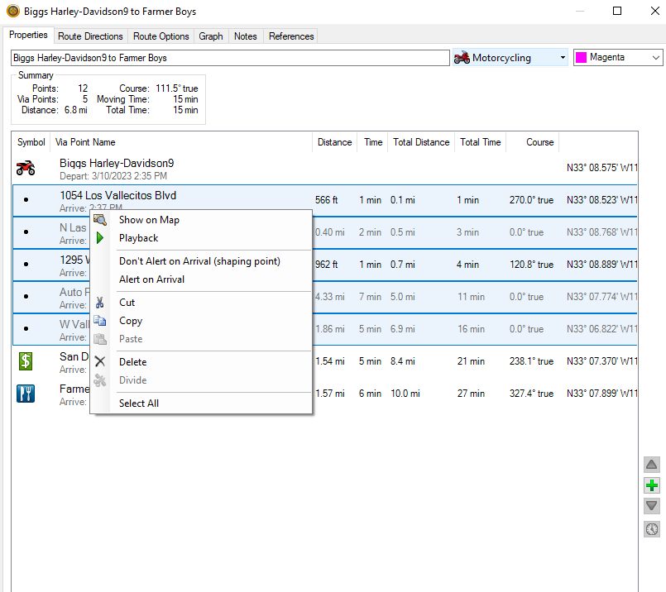
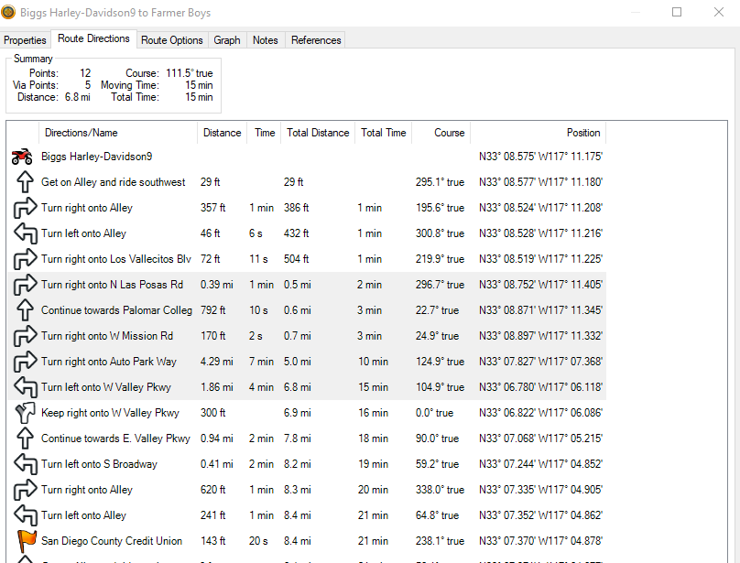
Creating the Spreadsheet
To do this, on the “Properties” tab of the route, highlight all points except the start, end, and any mid point stops. Right click and select “Don’t Alert on Arrival”.

Slide 30
Creating the Spreadsheet
Select the Route Directions tab.
Click on the starting point, then ctrl + A to select all the points.
Copy all the selected points by using ctrl + C.

Slide 31
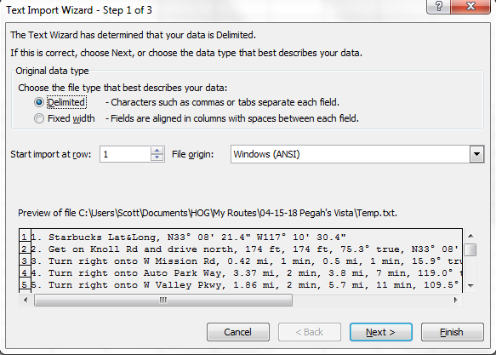
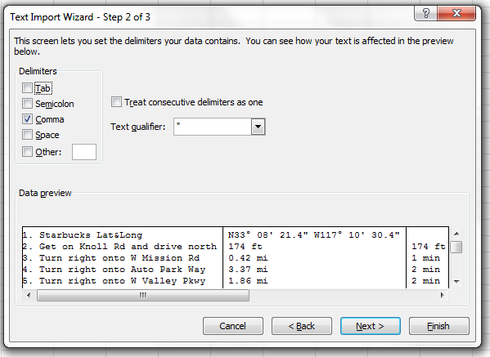
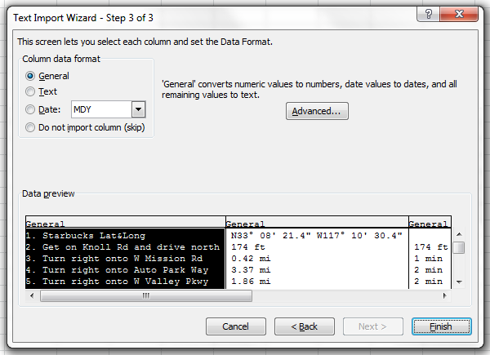
Creating the Spreadsheet
Start Excel with a new “Workbook”. Under “Paste” select “use Text Import Wizard”. Choose the following import options.

Slide 32
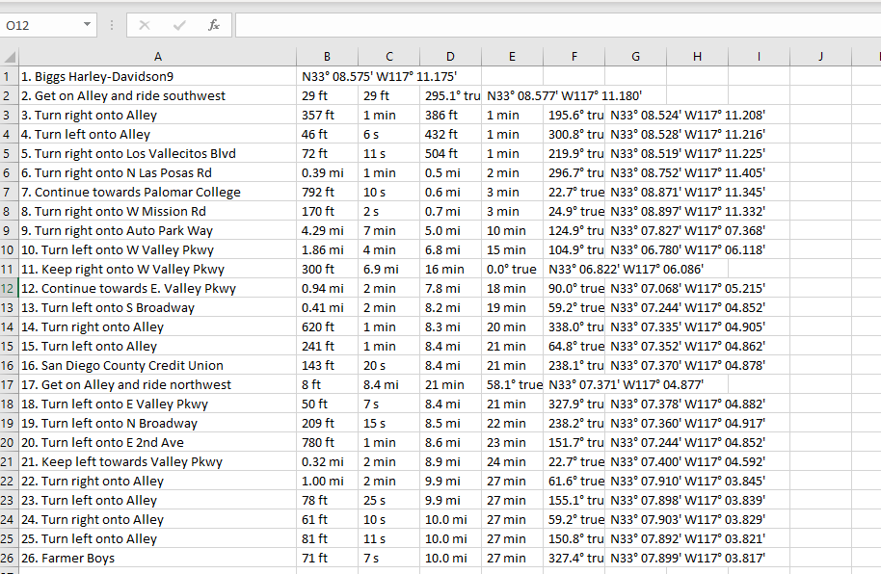
Creating the Spreadsheet
The only columns we need to keep are column A (description) and column D (total distance). The other columns may be deleted. But first we’re going to move column D.

Slide 33
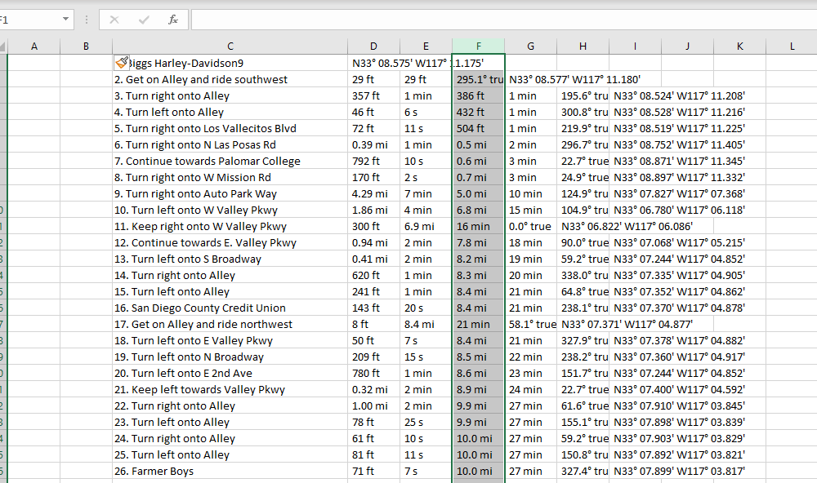
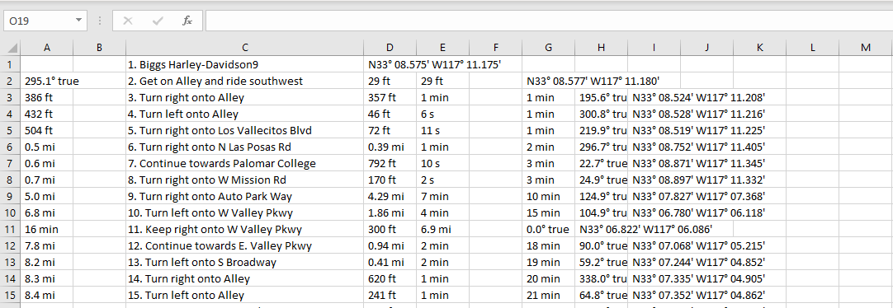
Creating the Spreadsheet
Insert two new columns before the description column and select column F. Right click “F” and select “cut”. Select column A, right click and select paste.

Slide 34
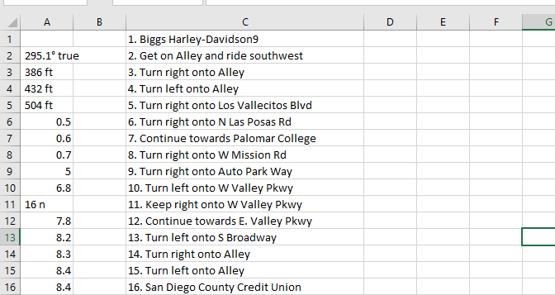
Creating the Spreadsheet
Delete all columns to the right of column C.
Use the “Find & Select” menu item to change miles to digits only. Select column A, click the down arrow of “Find & Select” and select “Replace”, in the “Find what:” box type “mi” and select “Replace All”. Then click “Ok” then click “Close”

Slide 35
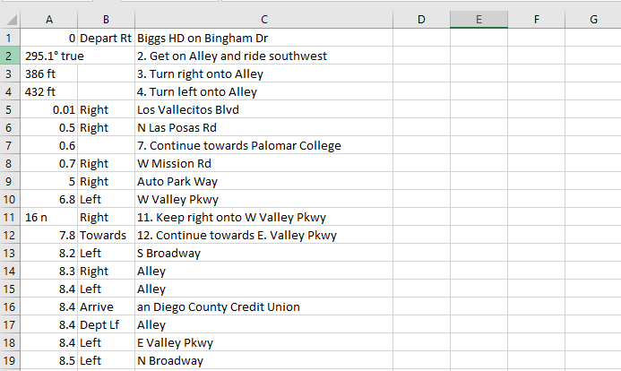
Creating the Spreadsheet
Add directions for each leg in column B and “clean up” the description in column C.

Slide 36
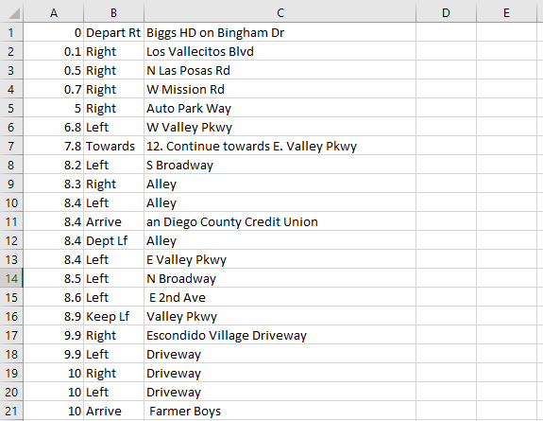
Creating the Spreadsheet
Delete the used rows.

Slide 37
Creating the Spreadsheet
The spreadsheet is now almost done.
Download and save the attached route template.

Slide 38
Creating the Spreadsheet
Open the template in Excel.
Change the title and the brief times in the template.
At this point save the spreadsheet as the same name as your GPX route.

Slide 39
Creating the Spreadsheet
Next copy the cells from your working route to the new spreadsheet.
Switch views to your working route. Select only the cells with data. Switch views back to template, click in cell A4 and paste the data in.
You notice in cell D4 you now have a distance. Click in that cell, hover your mouse over the lower right corner until it changes to a black cross. Press and hold the left button and drag down to the next to last row to fill in the remaining distances.
At the bottom add in destination ETA.

Slide 40
Creating the Spreadsheet
High light cells A3 to the bottom right D cell. On the “Home” tab, click the dropdown arrow under “Format as Table” select the third row left most table box. In the popup box select “Ok”. Screen switches to “Table Design” view. Click “Convert To Range” on the left side, then click “yes” in the popup box.
In the row below last instruction enter “Feather Pin Ride Ends at Destination.”

Slide 41
Creating the Spreadsheet
Copy & paste a “snippet” of the BaseCamp map at the bottom.
Save this spreadsheet with the same name as your route.

Slide 42
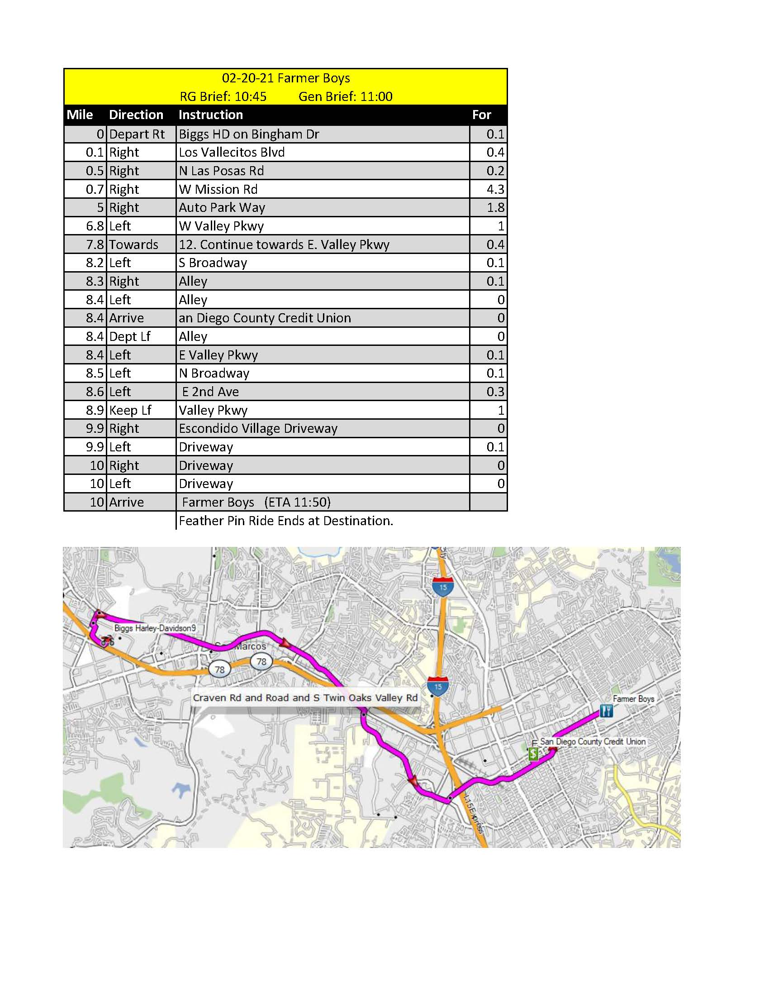
Done!

Slide 43
Exporting Route & Spreadsheet
Three files are sent to the Activities chairman.
A BaseCamp GPX file.
A BaseCamp KML file
The Excel XLSX file.
To export the BaseCamp files, click on the route in your library. Select “File” from the menu, the “Export”, then “Export Route Name”. Save these files in the same folder with your spreadsheet. Repeat the process for the KML file but change the “Save as Type:” to KML.
Send all files to: activities@biggshog.com

Slide 44
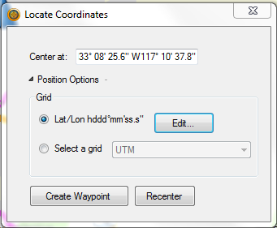
Tips & Tricks – Add an exact location from Google Earth
You can add a specific point found in Google Earth to BaseCamp by doing the following.
In BaseCamp click on “Find” then “Locate Coordinates” and set the Grid options as shown below.

Slide 45
Adding a Point from Google Earth
Launch (or view from BaseCamp) Google Earth and then find the point you wish to add into BaseCamp by selecting the placemark tool. Drag the “New Placemark” box to where you desire (in this case the entrance to Bates Nut Farm) and copy down the latitude and longitude.

Slide 46
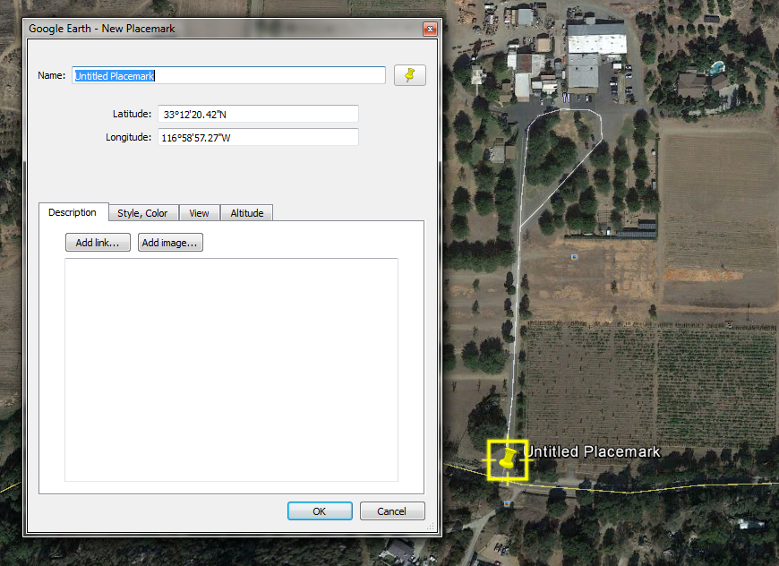
Adding a Point from Google Earth

Slide 47
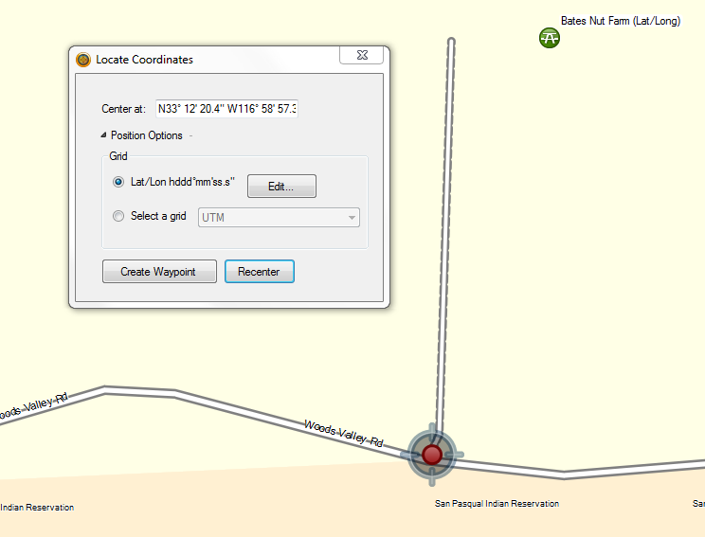
Adding a Point from Google Earth
Return to BaseCamp and then select “Find” then “Locate Coordinates” and fill in the latitude and longitude you just copied down. Be careful to copy it in using the same format. Then select “Create Waypoint.”
You can treat this new waypoint as any other waypoint in your route.

Slide 48
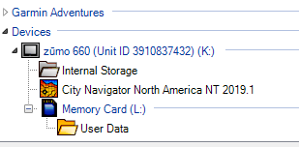
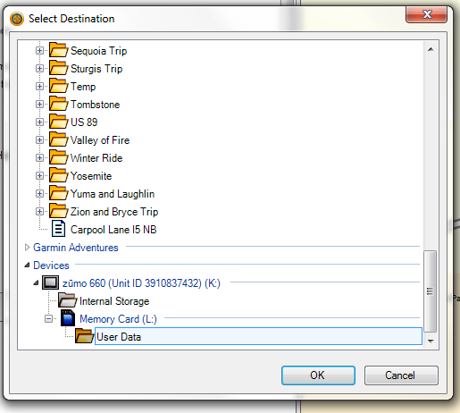
Tips & Tricks – Sending to Garmin
With your Garmin connected and showing in Devices
Highlight the list you wish to send and then right click.
Select “Send To”
The “Select Destination” box will open and select your device. (Preferably the Memory Card/User Data folder.
On your device, import the route.

Slide 49
Tips & Tricks – Importing to Boom Box Infotainment System
Copy the GPX file to a USB thumb drive.
Connect the USB thumb drive to your Boom Box.
From Navigation Main Menu, Select “Menu” (top left on menu bar)
Select “Import” and then highlight the desired route by clicking on it.
The route along with all the waypoints will be displayed. Select just the route, not “Select All.”
Click on “Import” then “OK”

Slide 50
Thanks for attending
If you have any questions, please feel free to contact any one of us for help.
Let’s start planning some routes.

