Slide 1
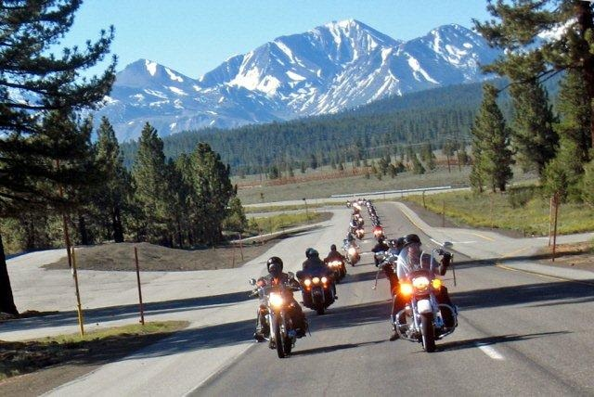
Formation Riding 201
Focusing on Issues Pertinent to Chapter Long-Distance Rides
Biggs Chapter
North San Diego County
Harley Owners Group
P.O. Box 610
San Marcos, CA 92079
Website: BiggsHOG.com
Ride Line: 760-736-2920

Slide 2
Message From the Director
Welcome to Formation 201, an extension of our Formation 101. This class focuses on issues pertinent to our long-distance rides.
Our Formation 101 class provides a solid foundation of knowledge of our riding policies and procedures. As our long-distance riding program has evolved, we have learned that there are some issues of long-distance group riding that are beyond the scope of Formation 101. This presentation was developed to address some of those issues.
We welcome members and guests on our rides, both local and long distance. We hope that this presentation will enhance your enjoyment of our chapter’s long-distance program as you ride, have fun and make new friends.
Biggs Chapter North San Diego County H.O.G.

Slide 3
Formation 201 Structure
Introduction
Before the Ride
The Ride
The Destination
The Ride Home
After the Ride

Slide 4
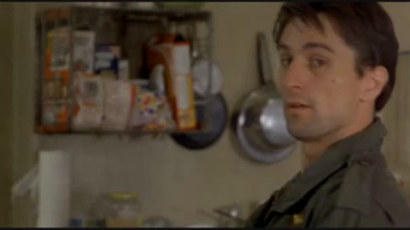
Introduction
Am I talking to you?

Slide 5
Introduction
Am I talking to you?
Yeah, I might be talking to you…

Slide 6


Don’t Let This Happen
I see we have enough room to land right there between the two motorcycles….

Slide 7
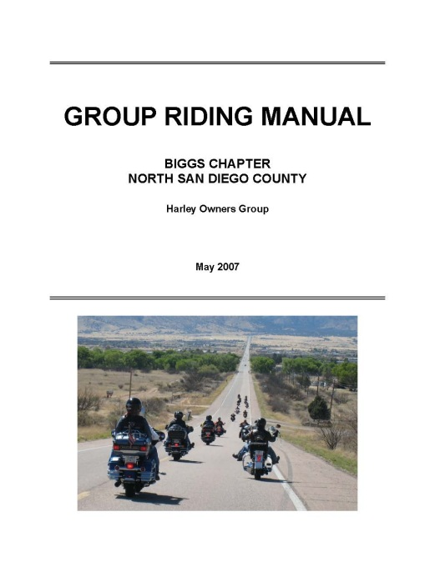


About This Course
Nothing in this course conflicts with the subject matter in our Formation 101 course or our Group Riding Manual. Rather, this course builds upon the basic group riding techniques discussed in the Manual and in Formation 101.
Therefore, it is important that you are familiar with our Group Riding Manual and attend Formation 101 in addition to attending this course.

Slide 8
About This Course – Cont’d
As with any ride, members may invite guests to participate in Long Distance or Overnight rides.
We strongly encourage all LD or Overnight riders to attend F-101 and this course. When you invite a guest, you should arrange your guest’s attendance at F-101 and this class.
When this isn’t possible, you should spend some time with your guest discussing our group riding techniques.

Slide 9
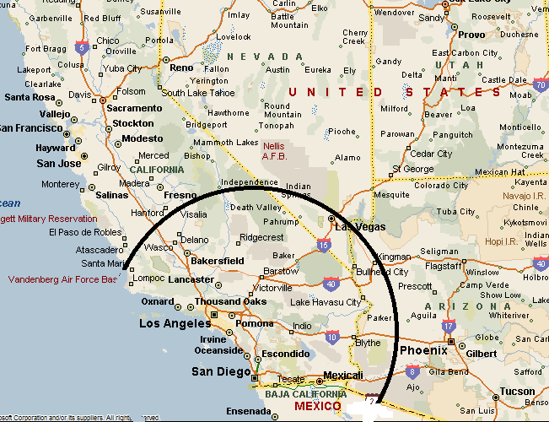
Definitions
Overnighters. Trips of two consecutive days (one night on the road). Typically no more than 300 miles each way.
Long Distance (LD) trips. Trips longer than two consecutive days (multiple nights on the road). Typically 300+ miles each way.
Unless otherwise noted, everything in this presentation applies to both overnighters and LD trips.

Slide 10

A Word About Our Road Guards
On most LD and overnight trips, arrival at the destination marks the end of the formal road guard assignments for the trip.
During the day rides and the ride back home, road guards are free to change groups based upon their personal preferences for that particular trip.
This means that the groups on day rides and the ride home won’t necessarily be the same as the original groups. In any case, you will not be left alone.

Slide 11
Overview of Long-Distance and Overnighters
Sign up is required for both of these trips.
LD coordinator selects hotel, arranges group rates and publishes booking information. You are responsible for making your own hotel reservations. Do not cancel without first contacting LD coordinator.
Groups are pre-assigned. Please let LD coordinator know in advance of any special requests.

Slide 12
Overview of Long-Distance and Overnighters - Cont’d
Trips often include a scheduled stop for breakfast but no other meal stops.
Gas / rest / snack stops are scheduled at approximately every 80-100 miles.
On LD trips, optional day rides at the destination are available. Return trip home is much less structured. Times and groups will vary.

Slide 13
Formation 201 Structure
Introduction
Before the Ride
The Ride
The Destination
The Ride Home
After the Ride

Slide 14
Are YOU Ready For The Trip?
Have you attended Formation 101? Are your skills where they need to be?
Are you able to handle distances as described in the packet?
Are you able to handle challenges of heat, cold, rain, twisties for long periods?
Are you able to maintain freeway speeds of up to for extended periods?

Slide 15
Are YOU Ready For The Trip? – Cont’d
Are you taking all of your “meds” along?
How about your epi-pen?
Do you have any medical issues that might impact your ability to ride?

Slide 16
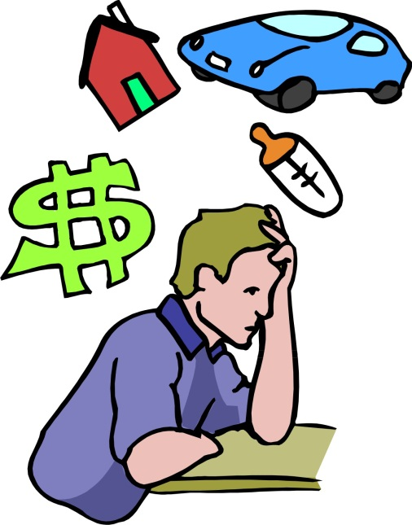
Is Your HEAD Ready For The Trip?
Do you have personal issues that will distract you while on the road?
Do you really dislike riding in certain conditions such as heat, cold, freeway, twisties, etc.?
If your head won’t be in the game, you could be a liability to yourself and others.

Slide 17
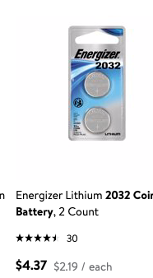
Is Your GEAR Ready For The Trip?
Do you have an extra set of keys?
When did you last change your fob battery?
Battery is 2032 and cheap. Buy one tomorrow.
Can you disarm security system without fob?
Do you have multiple ways to purchase fuel?
Total trip miles ~ 1,425
Approx miles at Chevron Stations ~ 1,200
1,200 miles / 40 mpg = 30 gallons of gas at Chevron Stations
30 Gallons x $3.00/gallon = $90

Slide 18
Is Your GEAR Ready For The Trip? – Cont’d
Do you have rain gear?
Do you have different “layers” for different climates?
  Evaporative cooling vest?
  Vented clothing?
  Insulated/electrically-heated clothing?
Do you have an accessible means of carrying water?
Have you programmed your I.C.E numbers in cell?
Have you tested all of the above?
Do you have an umbrella?
Do you have some trash bags?
Do you have paper maps of the destination area?
Have you tested all of the above?

Slide 19
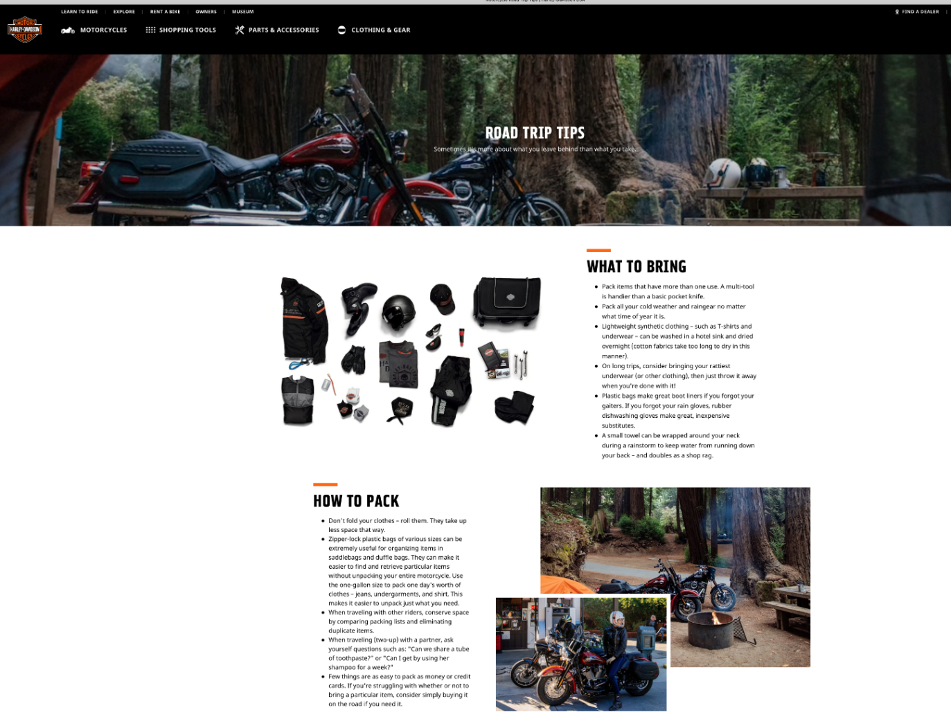
Is Your GEAR Ready For The Trip? – Cont’d
Any other suggestions?

Slide 20
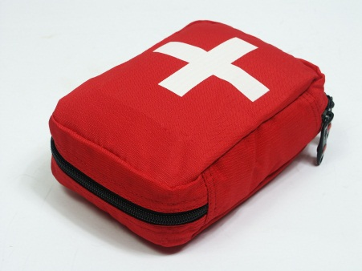
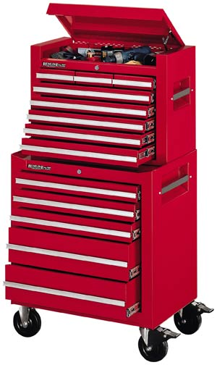
Is Your GEAR Ready For The Trip? – Cont’d
Have you considered a first aid kit?
  Have you checked contents lately?
  Is it packed where you can access it immediately?
Have you considered a tool kit?
  Have you checked contents lately?
  Consider sharing with a buddy.

Slide 21
Is Your GEAR Ready For The Trip? – Cont’d
Pack heavy items as low on bike as possible. Keep purse, wallet, snacks, first aid kit, sunscreen, rain gear handy.
Consider weighing your gear and checking your vehicle’s Gross Vehicle Weight Rating (GVWR).
Are you within weight limit?

Slide 22
Is Your BIKE Ready For The Trip?
Have any needed service done early.
Install any accessories in time to test locally before ride.
Consider optional roadside assistance programs offered by HOG.
Know range of your bike. Check route to ensure your bike can handle distances between gas stops.
If your bike has a fuel range of less than 125 miles, inform LD coordinator when signing up, and ride leader day of ride.

Slide 23
Signing Up
Make reservations early as there will be a deadline.
Inform LD coordinator immediately. You will then be on mailing list for the trip packages.
Your cell number is optional but very, very important. As circumstances or plans change on a ride, ride leader must be able to reach everybody.

Slide 24
The Ride Packet
LD coordinator will email packet to those signed up.
LD coordinator will update as plans firm up.
Read carefully. Many questions will be addressed in the packet.
Packets will contain cell phone numbers of those who registered their numbers with LD coordinator. Consider entering numbers of your ride leader and friends into your phone.
Print, sign and bring the waiver on the ride. LD waivers are unique, everybody, even members must sign a waiver.

Slide 25
The Ride Packet
“Did you read the package?”

Slide 26
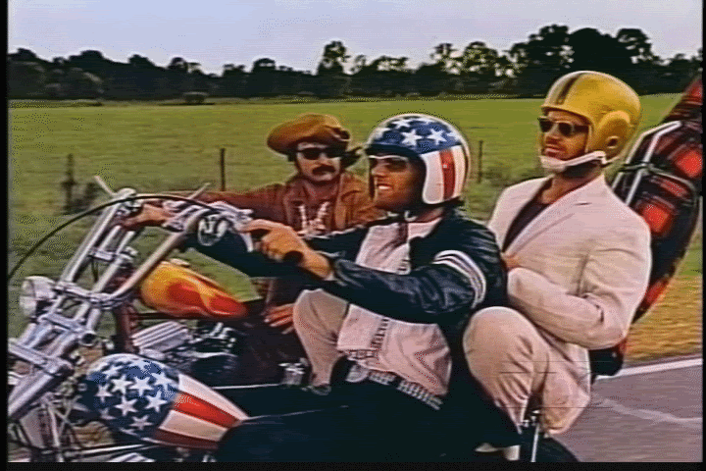
Formation 201 Structure
Introduction
Before the Ride
The Ride
The Destination
The Ride Home
After the Ride

Slide 27
The Day Of The Ride!
Arrive at rendezvous point early.
Typically Shell station on El Norte.
Bring completed waiver.
Call ride leader or LD coordinator if unable to make it.

Slide 28

Feather Pins
Pins, it’s all about the pins.
One feather pin per long distance or overnight trip.

Slide 29
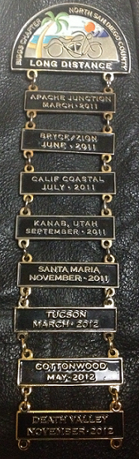
Long-Distance Pins
Pins, it’s all about the pins.
Long distance rides have additional unique pins. Top “suspension” pin is available at merchandise table at chapter meetings. LD coordinator will take sign ups and prepayment during the trip for the “dangler” for that trip.

Slide 30
Position and Spacing
The three most important things you can do while riding in a group:
1. Maintain your position and spacing.
2. Maintain your position and spacing.
3. Maintain your position and spacing.

Slide 31
Position and Spacing
Rubber Banding
Rubberbanding, gapping, drifting, failing to keep up, etc., it’s all bad.
Can compromise safety.
Will irritate fellow riders and road guards.
If you see something, say something to a Road Guard…

Slide 32

Maintaining Position and Spacing
Is it ME or my GAPPING that stinks?
Rubber banding-be alert for signs.
Are there large gaps in front of you?
Are you and others frequently accelerating and braking?
Others probably won’t address directly. Are nearby members in group asking to switch positions?
Do others, including road guards, frequently ask if you are “doing alright?”

Slide 33


Dangers of Using Cruise Control

Slide 34
Passing Large Trucks
Modified Stagger for Passing Large Trucks, Either Direction, 2+ Lanes in Same Direction
When approaching a large truck, from either direction, the bikes nearest the truck give a quick hand or leg signal and move laterally away from the truck, then back to resume position after passing truck.
Move only as far as comfortable.
Do not vary speed.

Slide 35


Passing Large Trucks
Modified Stagger for Passing Large Trucks, Either Direction, 2+ Lanes in Same Direction

Slide 36
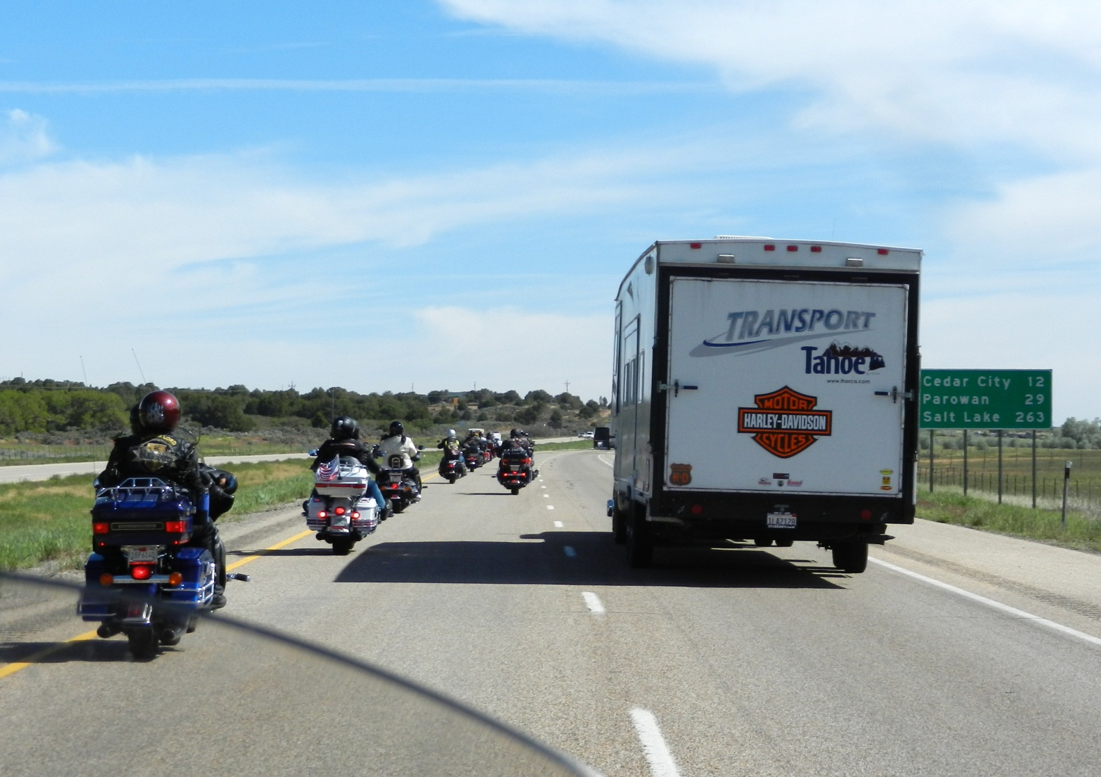
Passing Large Venicles

Slide 37
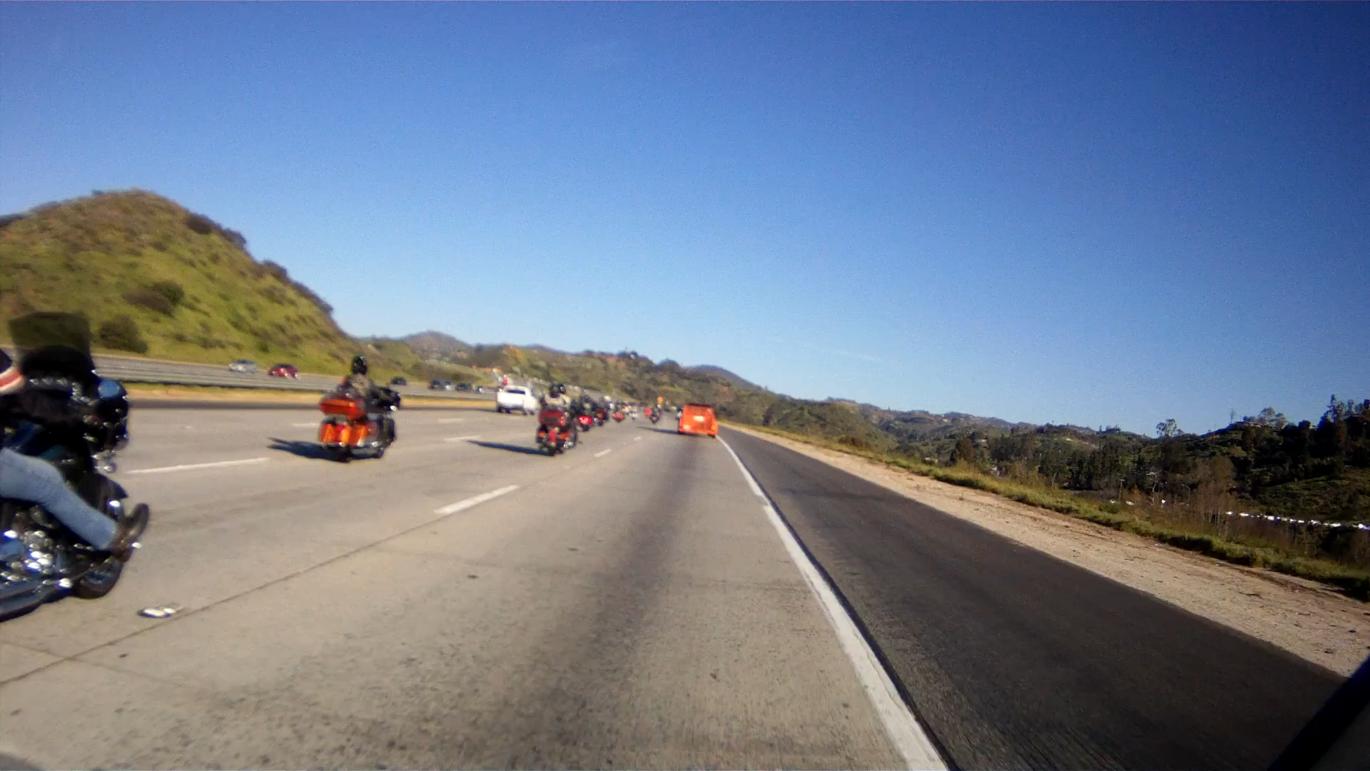
Passing Large Vehicles

Slide 38
Passing On Two Lane Road
To signal a pass, the ride leader will make a chopping motion.

Slide 39
Passing On Two Lane Road
Ride leader will pass and remain in lane.
Rest of group will pass as individuals.
More than one bike may move at same time, but don’t restrict other bike’s ability to move forward or back in the event of oncoming traffic.
Once past, move forward to make room for next bike.
Be patient!
Own your own safety.
Pass individually. Leave the other guy a way out.
Be patient!

Slide 40
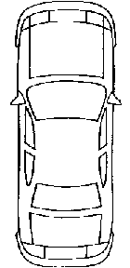
Passing On Two Lane Road

Slide 41
Stops Along the Route
Stops for Fuel, Rest, Food, Shopping, Sightseeing
Pulling into parking lots
  Follow group well into parking lot.
  Don’t leave sweep out in the street!

Slide 42
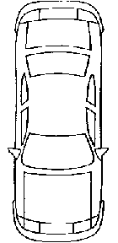
Watch this guy.

Slide 44
Stops Along the Route
Stops for Fuel, Rest, Food, Shopping, Sightseeing
Time…
It’s about respecting each others’ time.
Follow the ride leader.
If ride leader gets fuel, you get fuel.
If ride leader leaves helmet on, you leave your helmet on.
If ride leader prepares to depart, you prepare to depart.
See a pattern?

Slide 45
Stops Along the Route
Stops for Fuel, Rest, Food, Shopping, Sightseeing
Follow the ride leader.
If you are talking and everybody has their helmet on and appears to be listening intently, consider that they are waiting for you to quit talking and put your helmet on to depart.

Slide 46
Stops Along the Route
Stops for Fuel, Rest, Food, Shopping, Sightseeing
Remember…
It’s about respecting each others’ time.

Slide 47
Stops Along the Route
Stops for Fuel, Rest, Food, Shopping, Sightseeing
Eating, hydrating
  Typically we will stop for breakfast, but other “meals” will consist of snacking along the way.
  Never pass up a chance to hydrate!

Slide 48
Boredom
Fight boredom by
Carrying a music player with your favorite music.
Singing out loud.
Stocking up your tank bag with a supply of tart candies. A sour lemon drop will shock your senses and keep you going another twenty miles.
Do not push yourself to the point drowsiness sets in, even slightly!

Slide 49
Formation 201 Structure
Introduction
Before the Ride
The Ride
The Destination
The Ride Home
After the Ride

Slide 50
Day Rides at the Destination
Check packet and decide what you want to do.
Fuel up the night before so you are ready to go in the morning.
You are free to go on any day ride you want, or venture out on your own.
Day rides are generally led by a road guard, but might not have all three positions filled.

Slide 51
Alcohol
National HOG and our Chapter policies on alcohol remain in effect…You may not ride with us while under even the slightest effect of alcohol or any other substance that affects your ability to ride.
Once at the destination, and motorcycles are secured for the night, you may imbibe at your own discretion.

Slide 52
Common Courtesy at the Hotel
(The reason we always get invited back)
We respect the hotel, the hotel staff, and other guests.
Examples:
  We don’t use towels to clean an oil spill or our bikes.
  We don’t abuse the front desk staff.
  We don’t warm up our engines in front of guest rooms.

Slide 53

Keeping in Touch
Members will typically tend to gather around the pool, lobby or similar convenient location. This is where plans for meals, day rides and the ride home are usually discussed.
Use your cell phone. (Remember when we asked for your cell phone number?)

Slide 54
Formation 201 Structure
Introduction
Before the Ride
The Ride
The Destination
The Ride Home
After the Ride

Slide 55
The Ride Home
Like day rides, group structures and their departure times are flexible.
You are free to join any group, or ride home by yourself.
Check with a road guard the night before regarding departure times.
If you are not riding home with a group, please let LD coordinator or your group leader know.

Slide 56
Formation 201 Structure
Introduction
Before the Ride
The Ride
The Destination
The Ride Home
After the Ride

Slide 57
Back at Home
Provide feedback to long distance coordinator
Book your next trip!

Slide 58

Questions

Slide 59
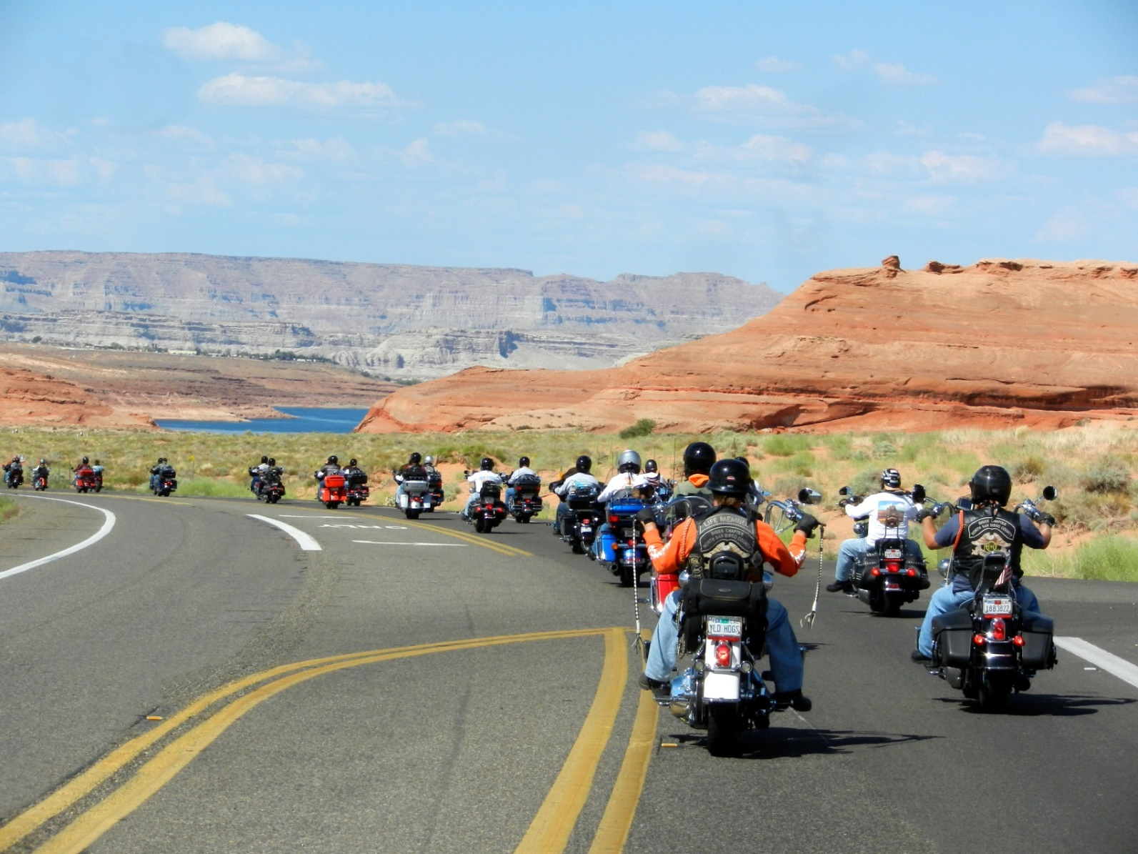
The End
Thank you!

